Slide 1

SS26
CPS FOOTWEAR
VLP
SS26 VLP – CPS FTW

Slide 2
TENNIS
SS26 VLP – CPS FTW

Slide 3
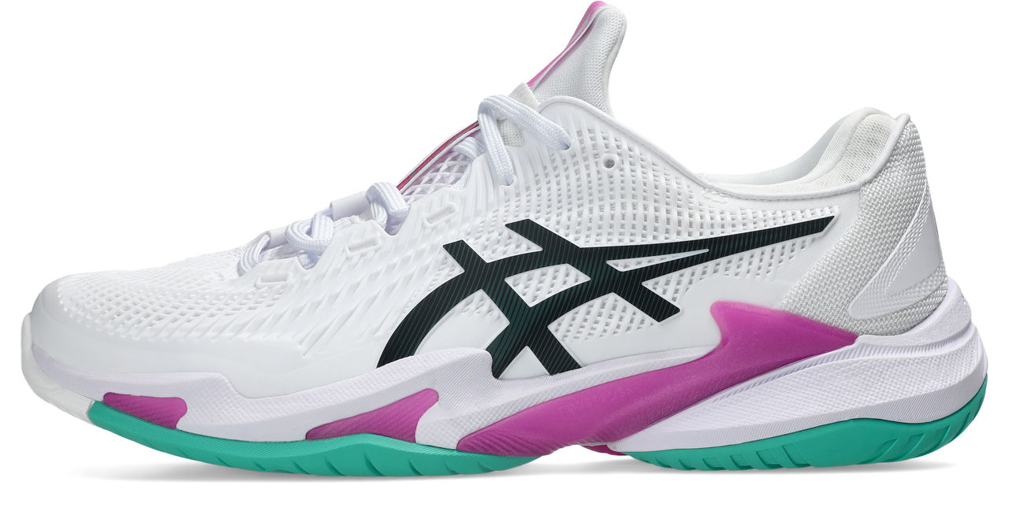
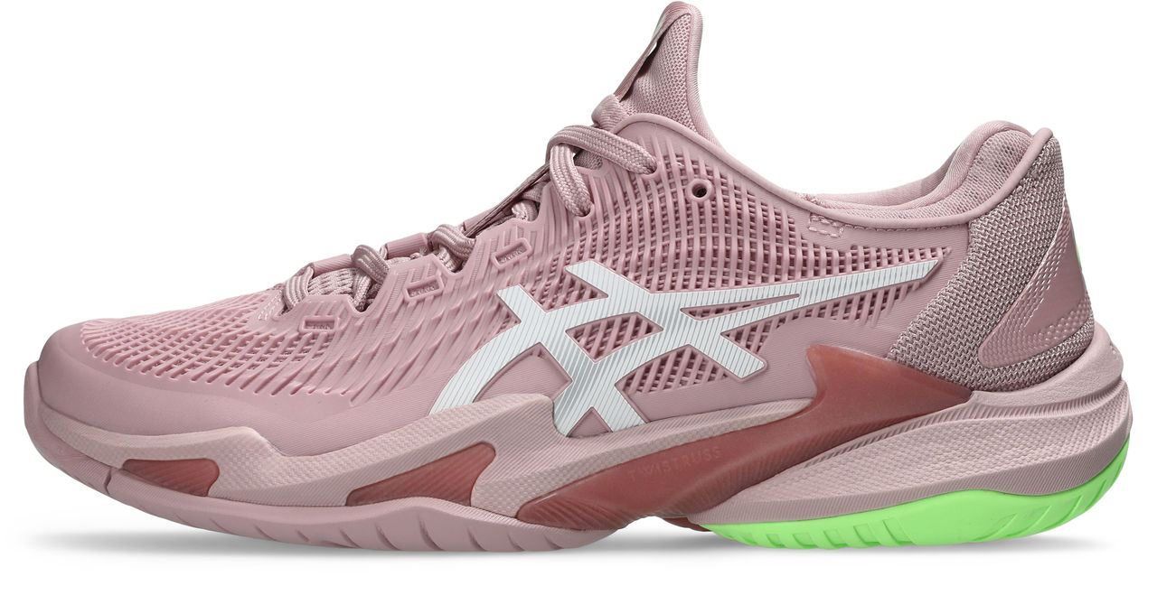
TENNIS
BEST OF BOTH
OUTSOLE AVAILABILITY
MEN
HARD COURT
CLAY COURT
INDOOR
COURT FF 3
106
CUD
€195
JAN
GOLD
1041A370
COURT FF 3 NOVAK
XXX
COURT FF 3 NOVAK
XXX
CUD
€195
JAN – AO
GOLD
1041A522
1041A521 (CLAY)
TBD
CUD
€195
APR – RG
GOLD
1041A522
1041A521 (CLAY)
TBD
WOMEN
COURT FF 3
701
CUD
€195
JAN
GOLD
1042A221 (CLAY)
SS26 VLP – CPS FTW

Slide 4
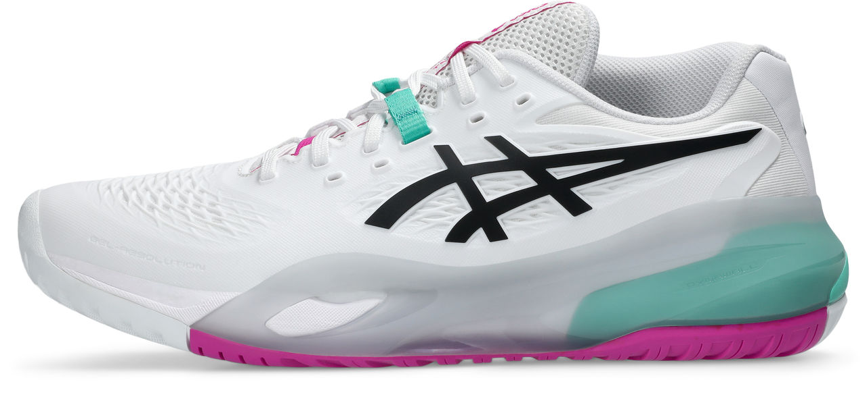
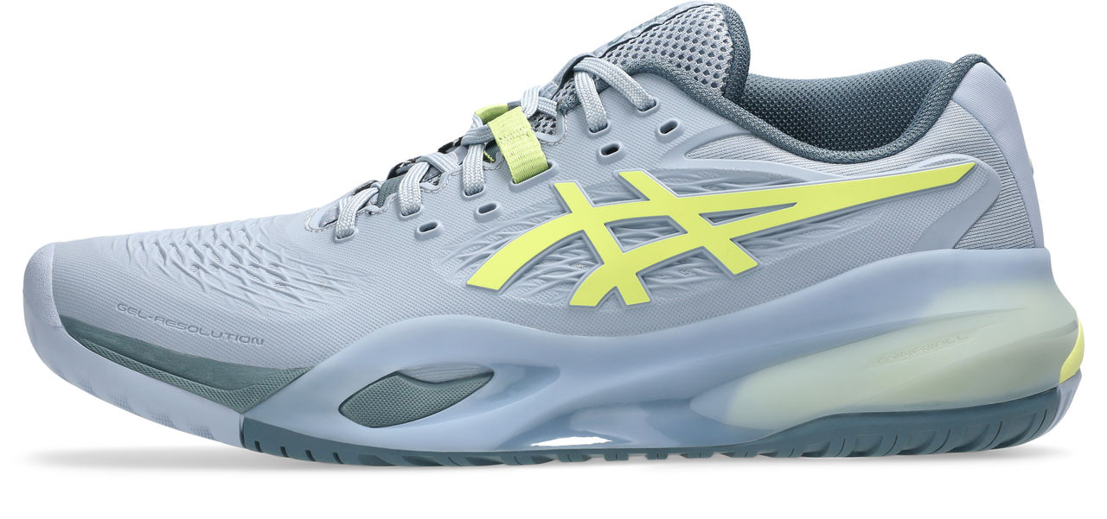
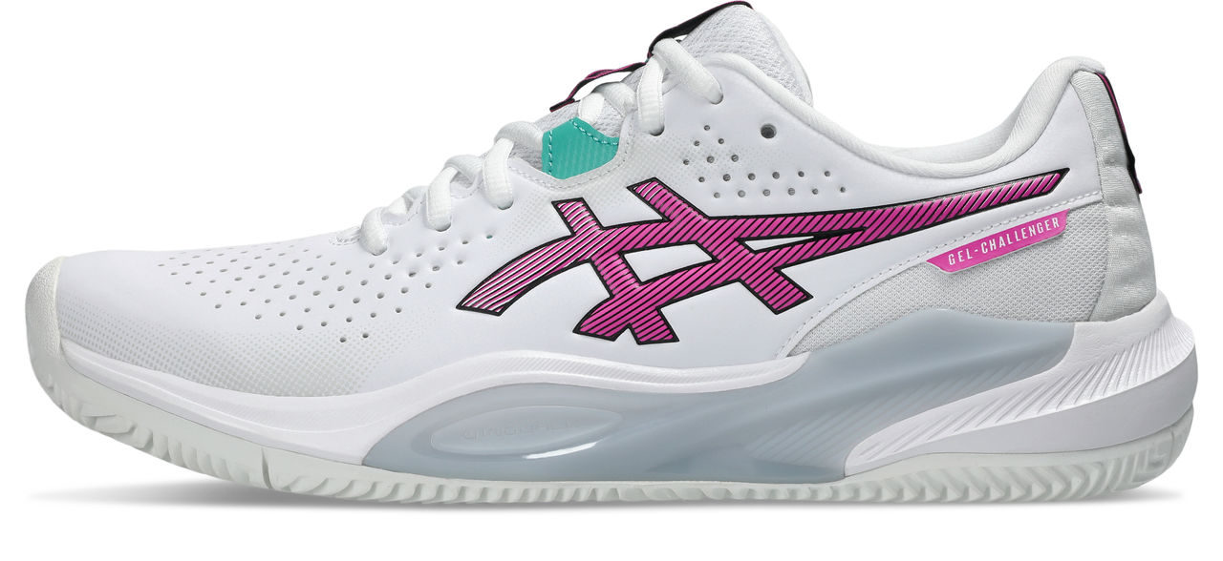
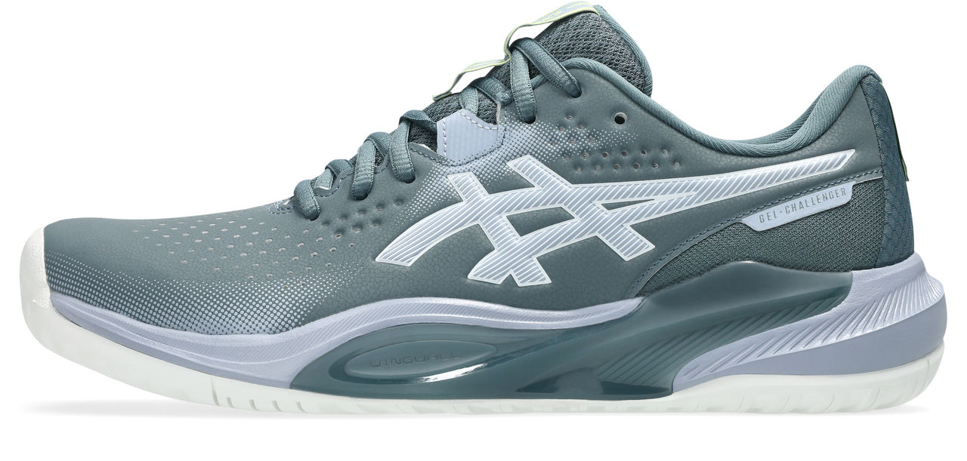
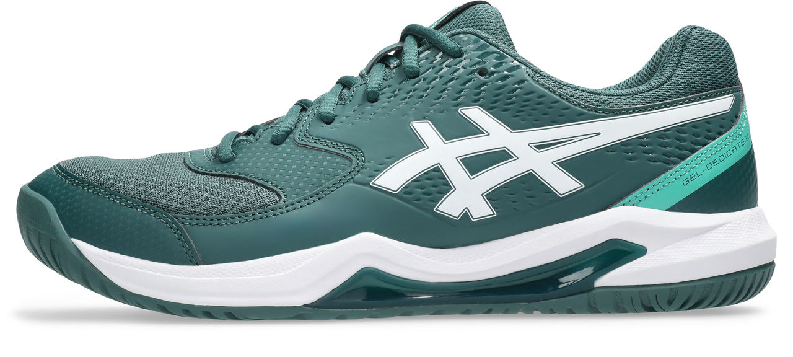
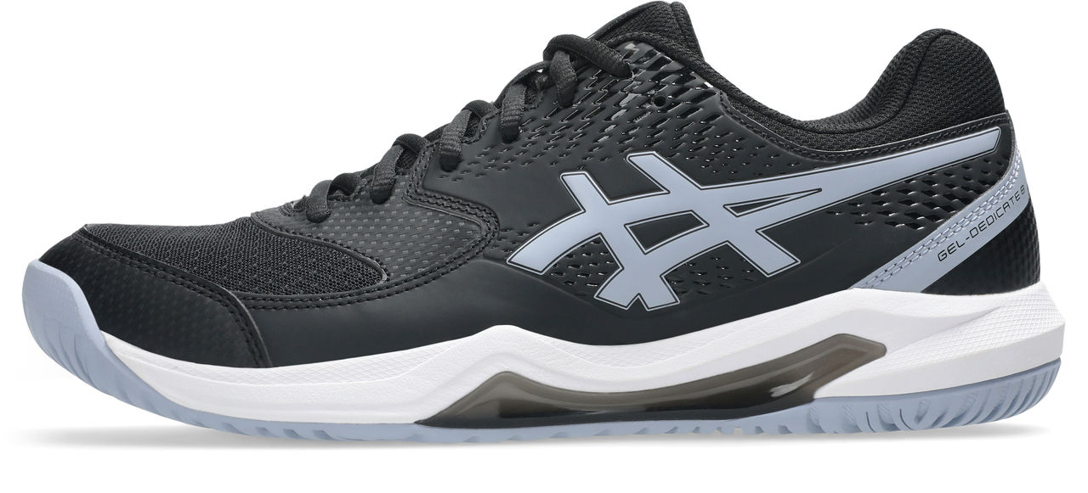
TENNIS MEN
BASELINE
OUTSOLE AVAILABILITY
HARD COURT
CLAY COURT
INDOOR
GEL-RESOLUTION X
103
402
GEL-RESOLUTION X​
CUD
€160
JAN - AO
GOLD
1041A481
CUD​
€160​
APR​ - RG
GOLD​
1041A481​
1041A485 (CLAY)
GEL-CHALLENGER 15
102
020
CUD
€130
DEC ‘25
SILVER
1041A510
1041A508 (CLAY)
GEL-DEDICATE 8
300
003
CUD
€79
DEC ‘25
SILVER
1041A408
SS26 VLP – CPS FTW

Slide 5
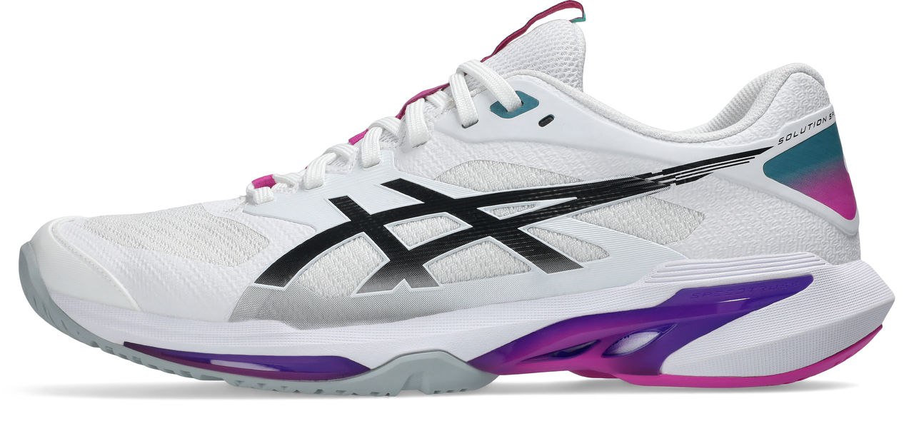
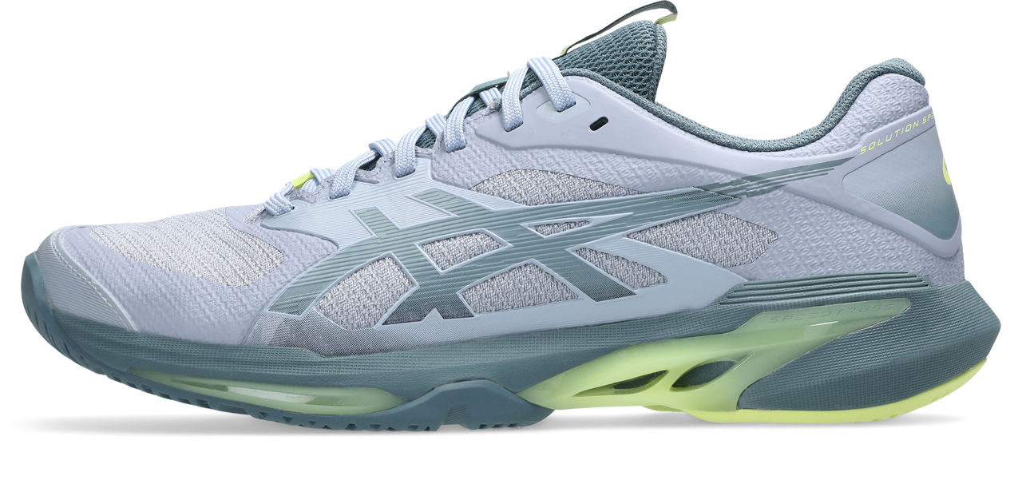
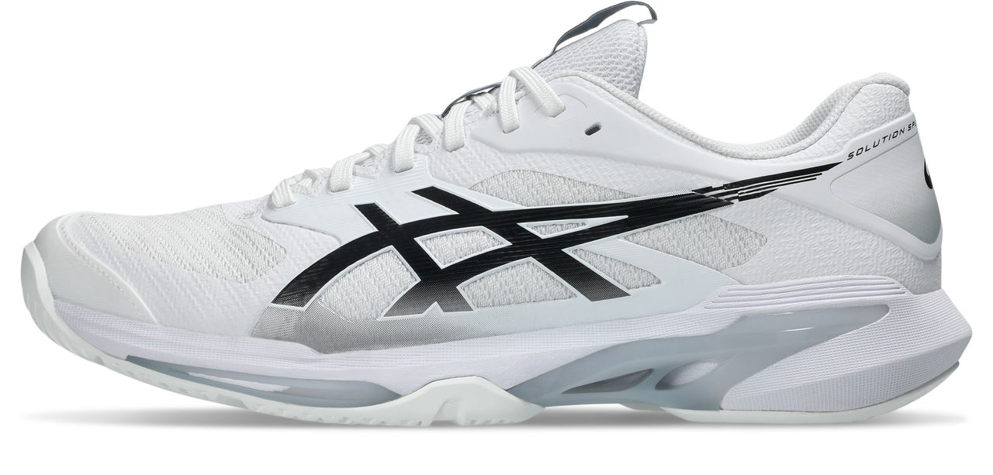
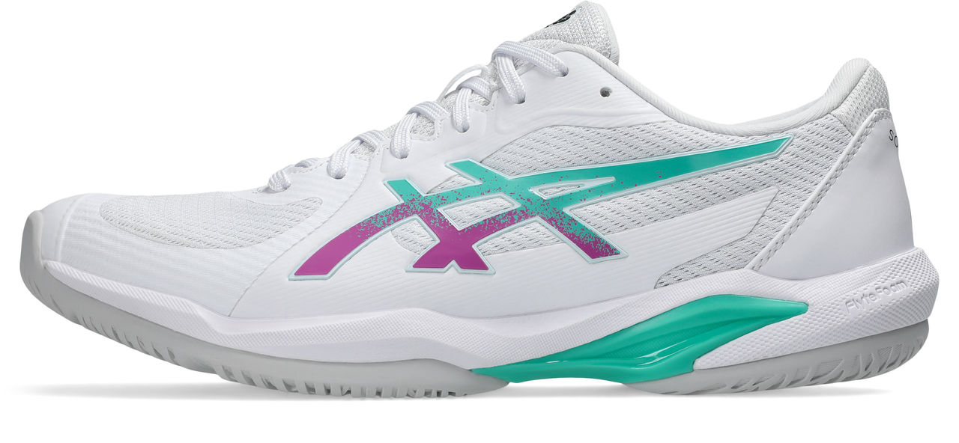
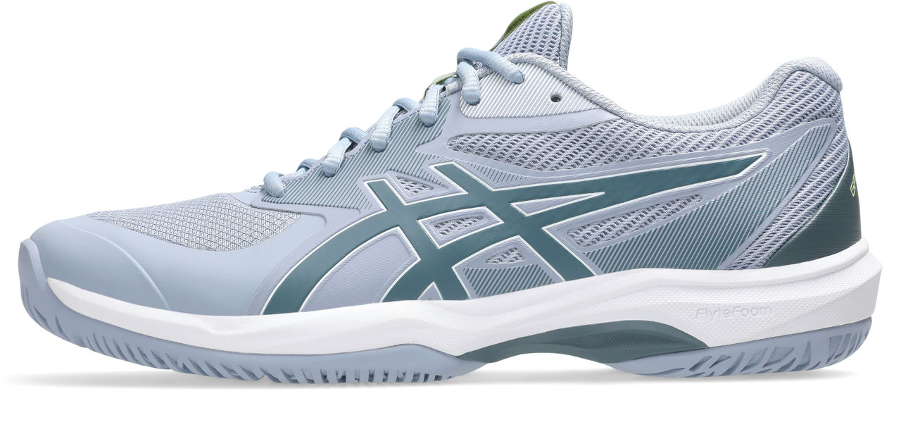
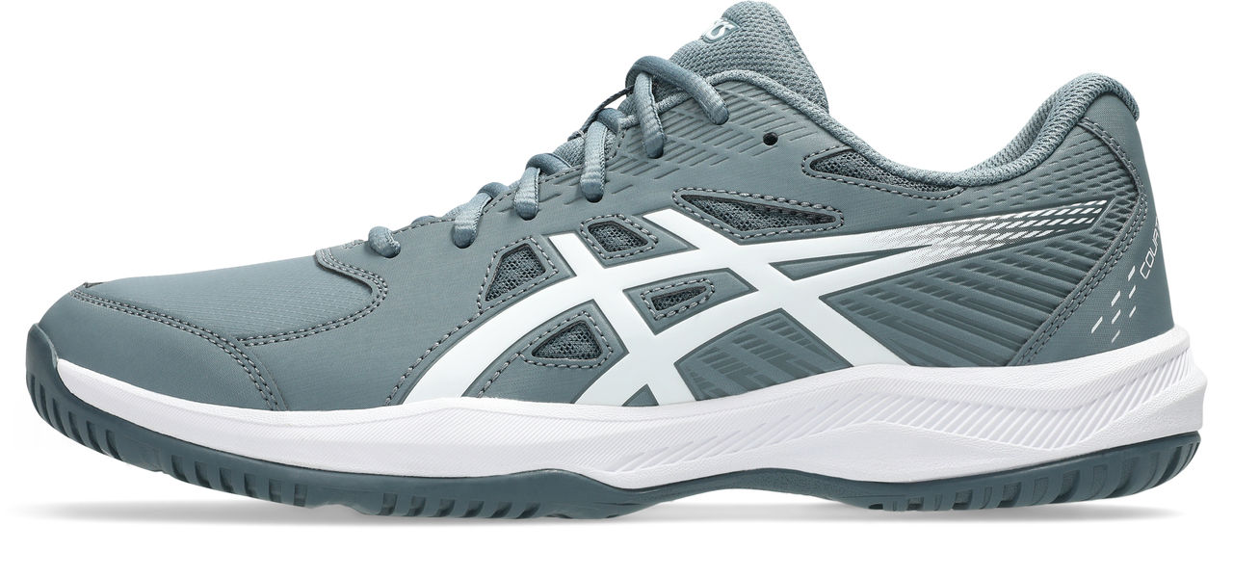
TENNIS MEN
ALL-COURT
OUTSOLE AVAILABILITY
HARD COURT
CLAY COURT
INDOOR
SOLUTION SPEED FF 4
101
SOLUTION SPEED FF 4
400
SOLUTION SPEED FF 4
100
NEW
€160
JAN - AO
GOLD
1041A532
NEW
€160
APR - RG
GOLD
1041A532
1041A533 (CLAY)
NEW
€160
JAN
GOLD
1041A532
SOLUTION SWIFT FF 2
104
CUD
€130
DEC ‘25
GOLD
1041A466
GAME FF
400
CUD
€100
DEC ‘25
SILVER
1041A489
COURT SLIDE 4
020
CUD
€65
DEC ‘25
BRONZE
1041A483
SS26 VLP – CPS FTW

Slide 6
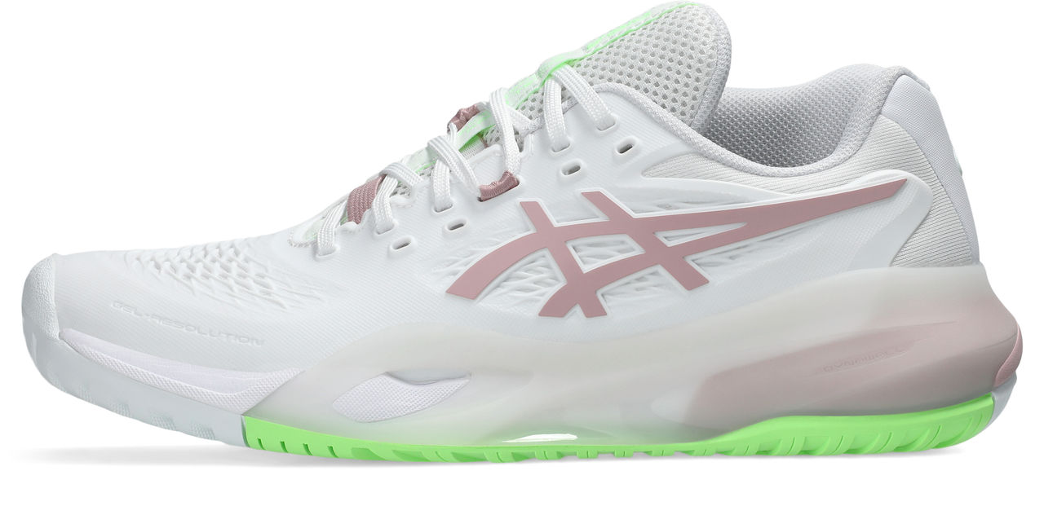
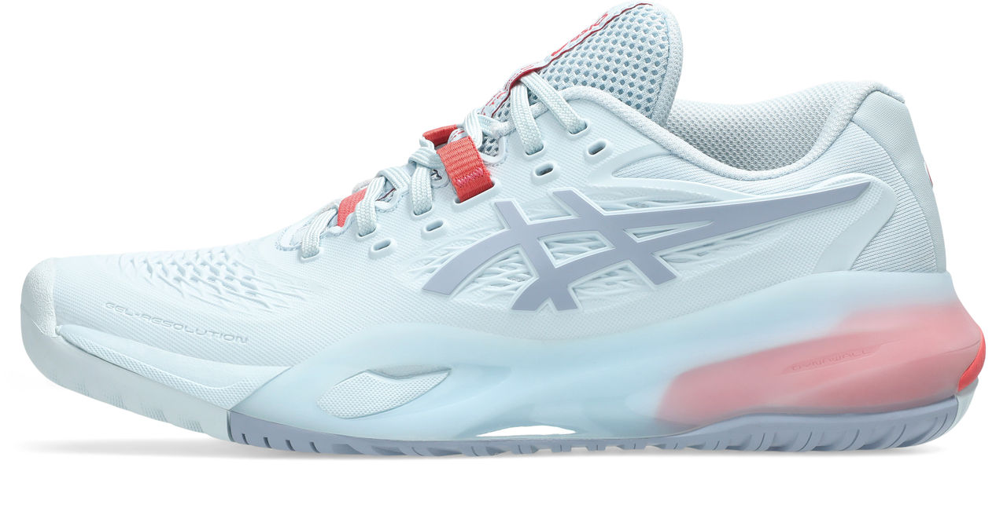
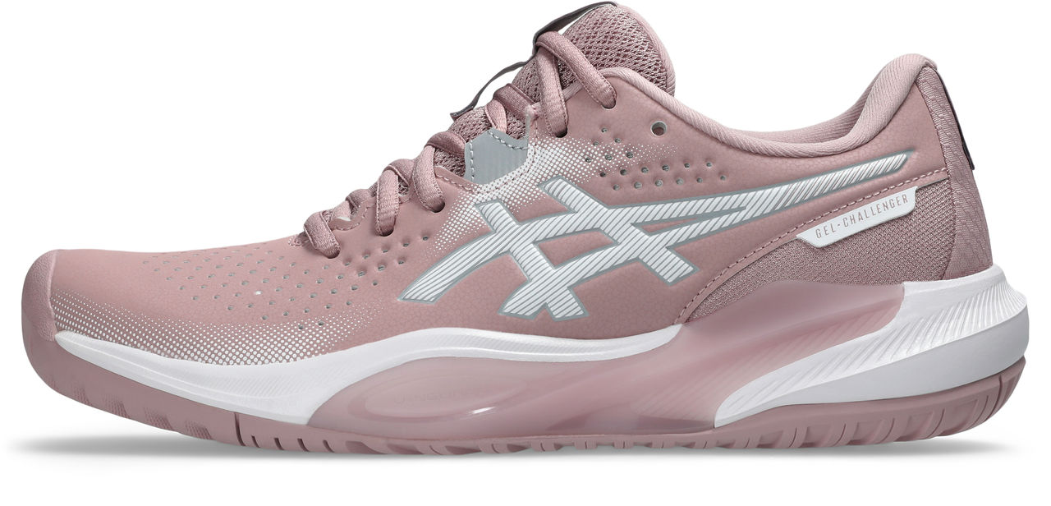
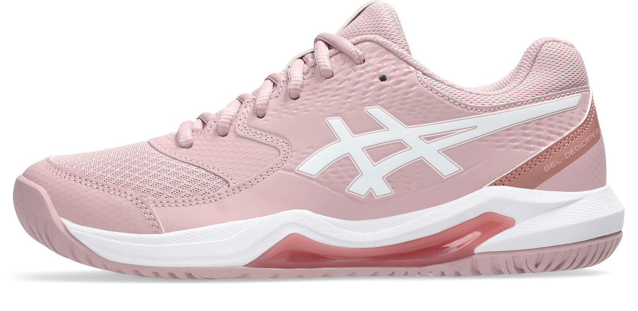
TENNIS WOMEN
BASELINE
OUTSOLE AVAILABILITY
HARD COURT
CLAY COURT
INDOOR
GEL-RESOLUTION X
104
GEL-RESOLUTION X
401
CUD
€160
JAN - AO
GOLD
1042A279
CUD
€160
APR - RG
GOLD
1042A277 (CLAY)
GEL-CHALLENGER 15
700
CUD
€130
DEC ‘25
SILVER
1042A294
1042A293 (CLAY)
GEL-DEDICATE 8
702
CUD
€79
DEC ‘25
SILVER
1042A237
SS26 VLP – CPS FTW

Slide 7
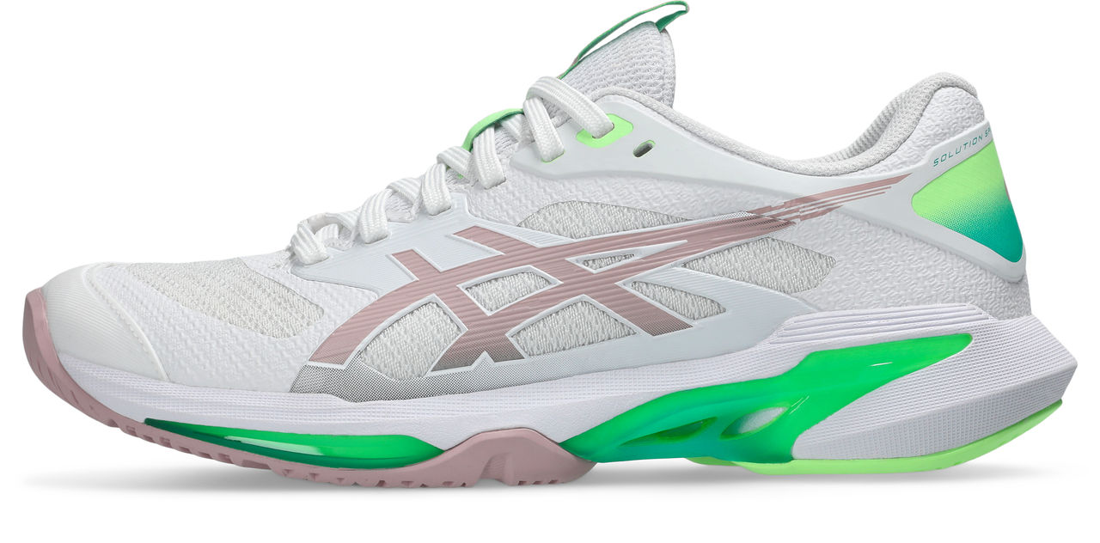
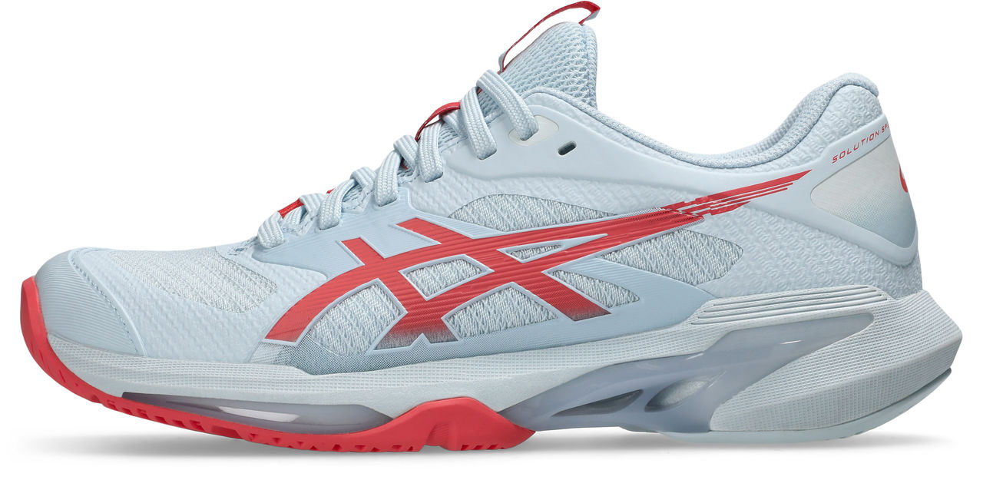
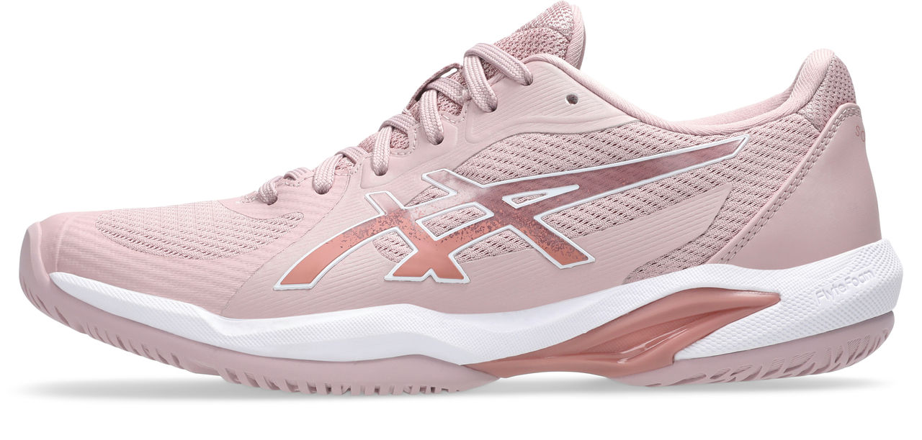
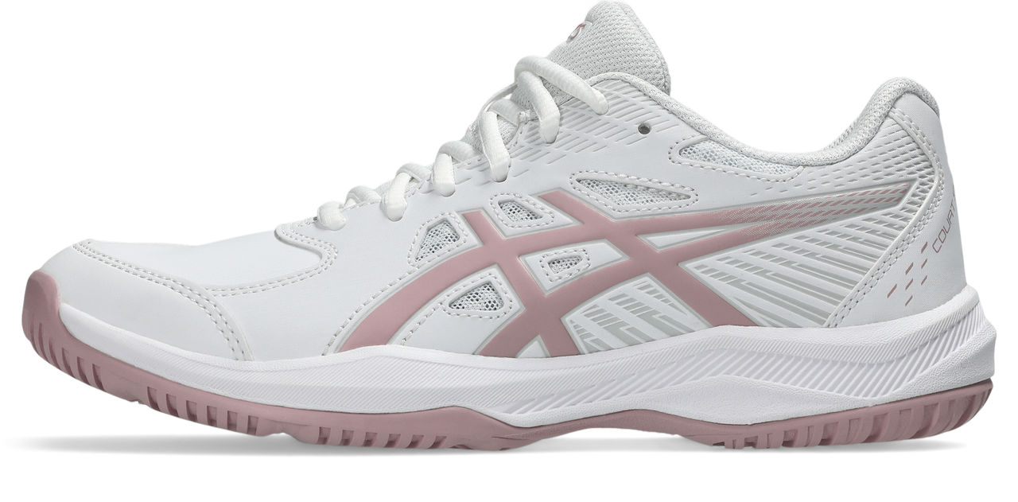
TENNIS WOMEN
ALL-COURT
OUTSOLE AVAILABILITY
HARD COURT
CLAY COURT
INDOOR
SOLUTION SPEED FF 4
100
SOLUTION SPEED FF 4
400
NEW
€160
JAN - AO
GOLD
1042A307
NEW
€160
APR - RG
GOLD
1042A307
SOLUTION SWIFT FF 2
702
CUD
€130
DEC ‘25
GOLD
1042A265
COURT SLIDE 4
102
CUD
€65
DEC ‘25
BRONZE
1042A283
SS26 VLP – CPS FTW

Slide 8
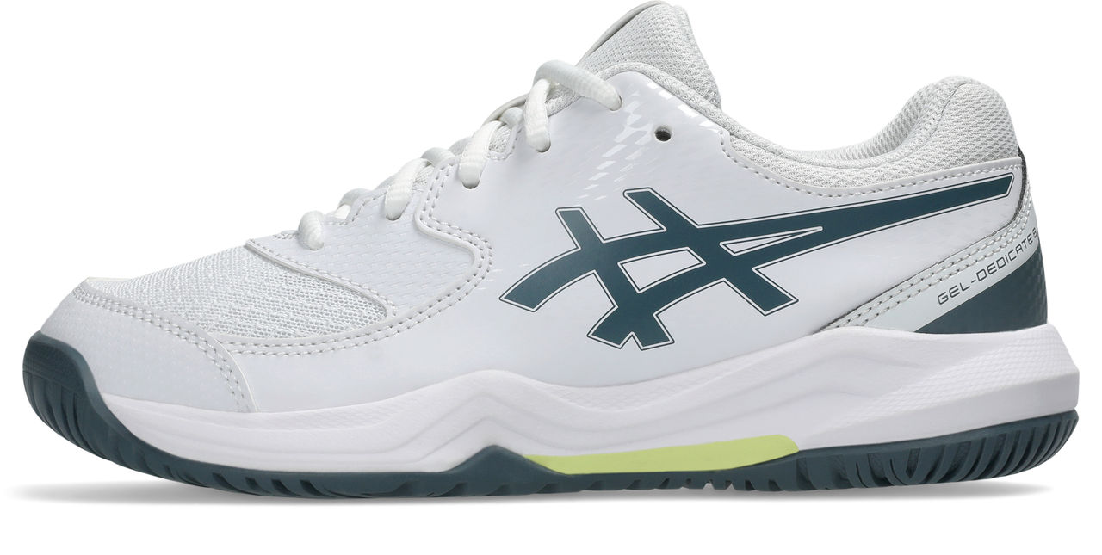
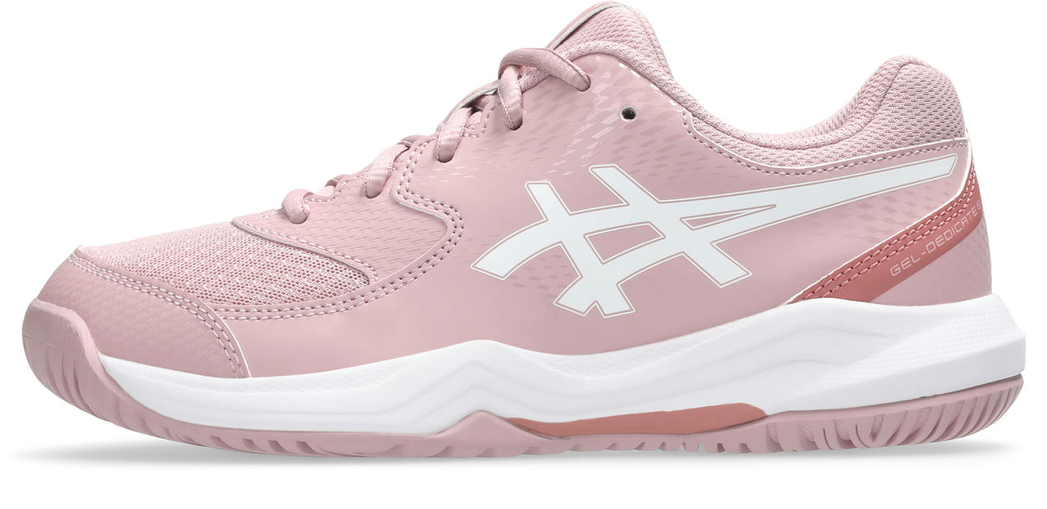
TENNIS KIDS
OUTSOLE AVAILABILITY
HARD COURT
CLAY COURT
INDOOR
GEL-DEDICATE 8 GS
108
702
CUD
€65
DEC ‘25
SILVER
1044A077
SS26 VLP – CPS FTW

Slide 9
PADEL
SS26 VLP – CPS FTW

Slide 10
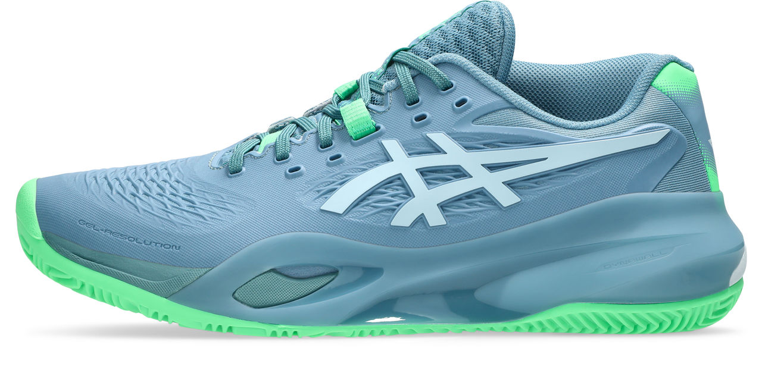
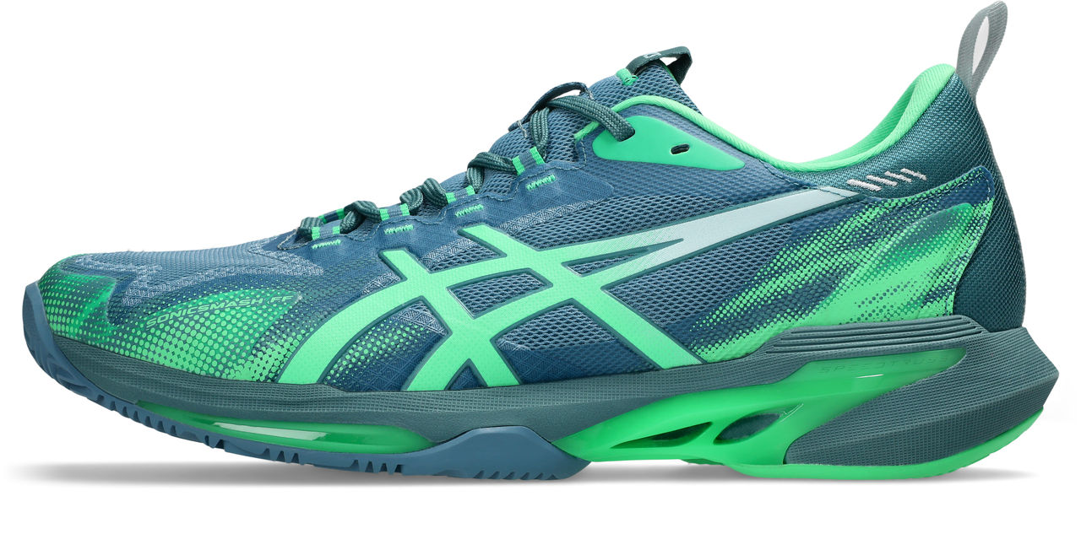
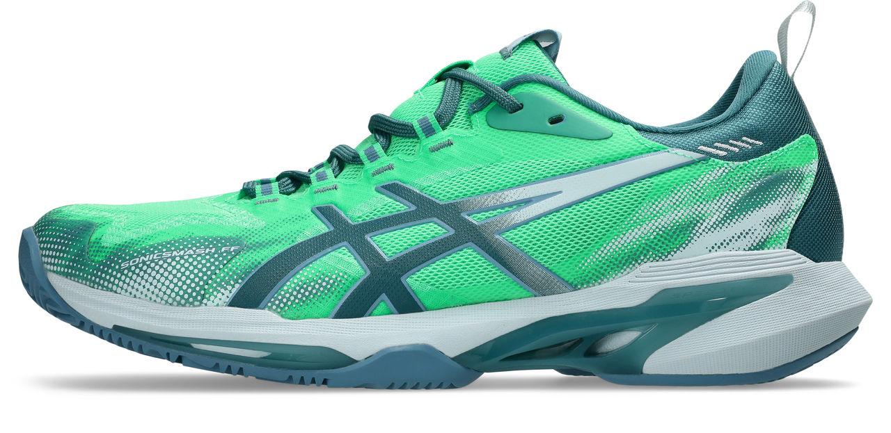
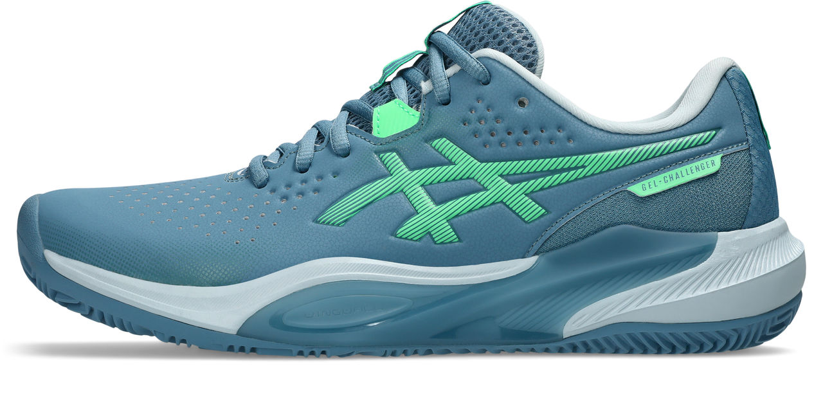
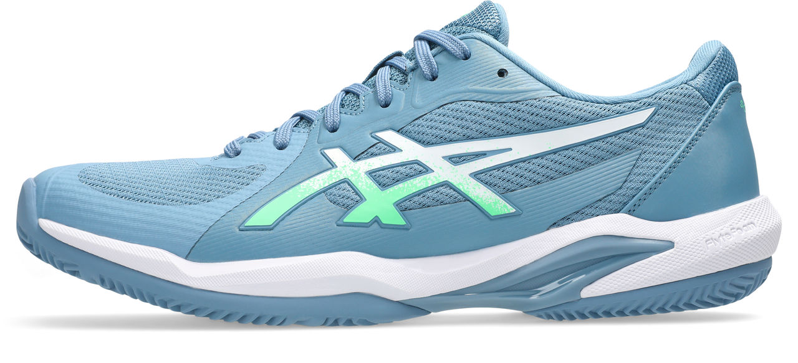
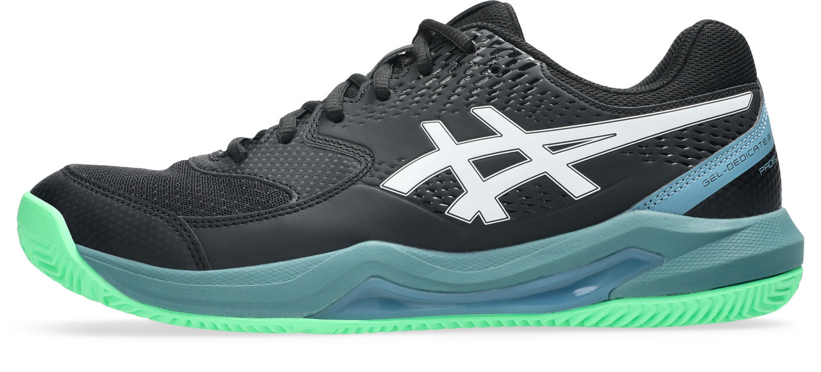
PADEL MEN
CONTROL
SPEED
GEL-RESOLUTION X PADEL
403
SONICSMASH FF
400
300
CUD
€160
DEC '25
GOLD
1041A492
NEW
€145
FEB
GOLD
1041A538
GEL-CHALLENGER 15 PADEL
400
SOLUTION SWIFT FF 2 PADEL
402
CUD
€130
DEC ‘25
SILVER
1041A511
CUD
€130
DEC ‘25
GOLD
1041A465
GEL-DEDICATE 8 PADEL
003
CUD
€79
DEC ‘25
SILVER
1041A414
SS26 VLP – CPS FTW

Slide 11
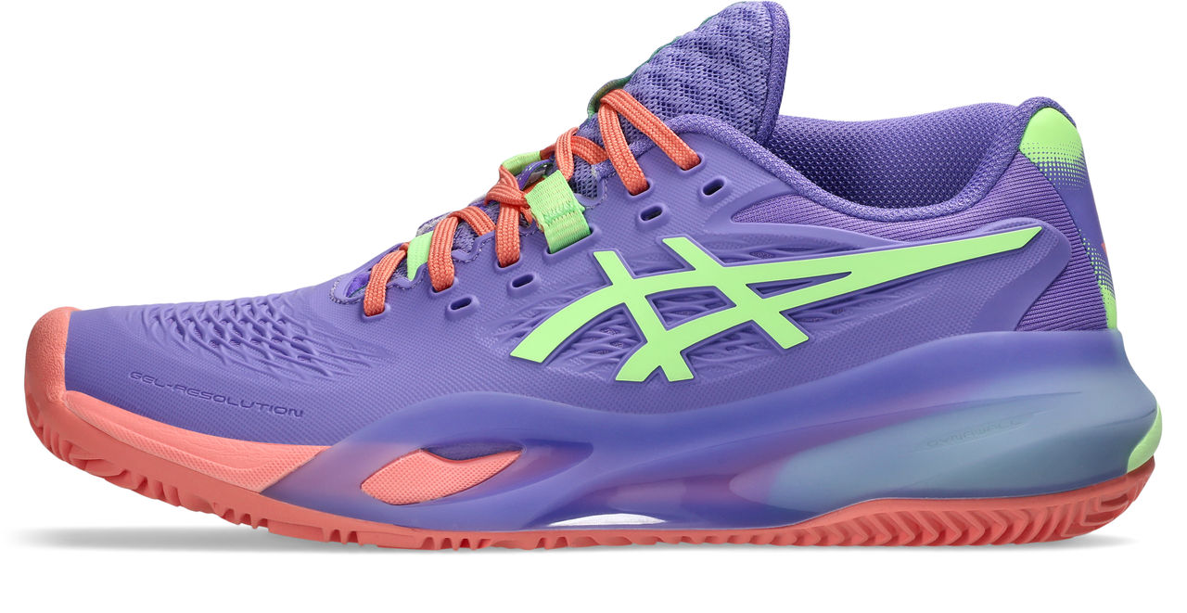
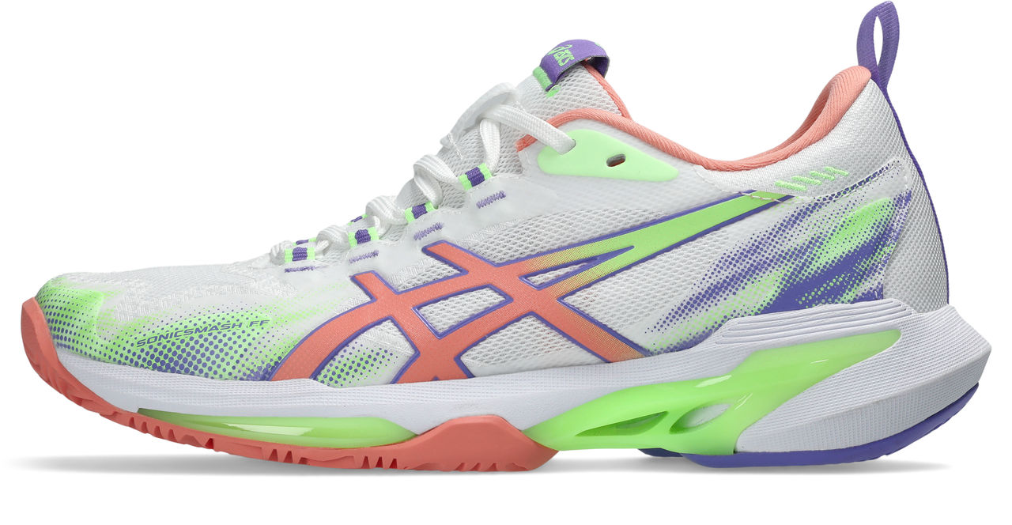
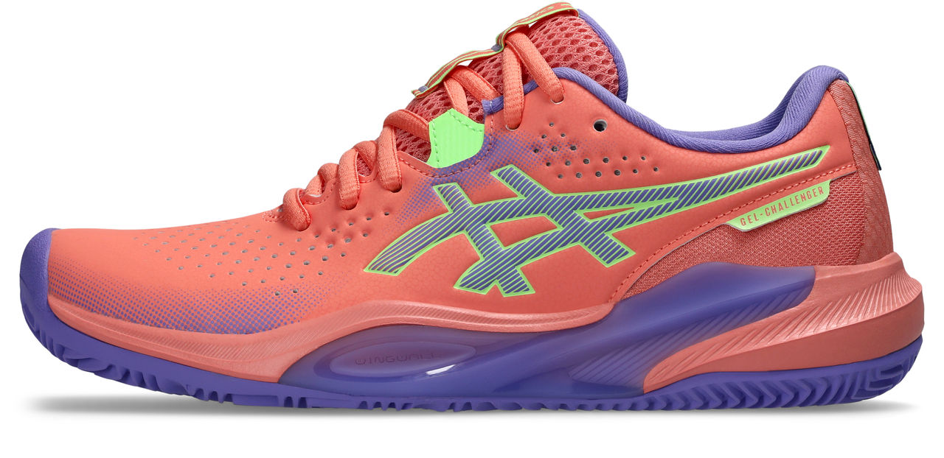
PADEL WOMEN
CONTROL
SPEED
GEL-RESOLUTION X PADEL
501
SONICSMASH FF
100
CUD
€160
DEC '25
GOLD
1042A285
NEW
€145
FEB
GOLD
1042A311
GEL-CHALLENGER 15 PADEL
700
CUD
€130
DEC ‘25
SILVER
1042A296
SS26 VLP – CPS FTW

Slide 12
INDOOR
SS26 VLP – CPS FTW

Slide 13
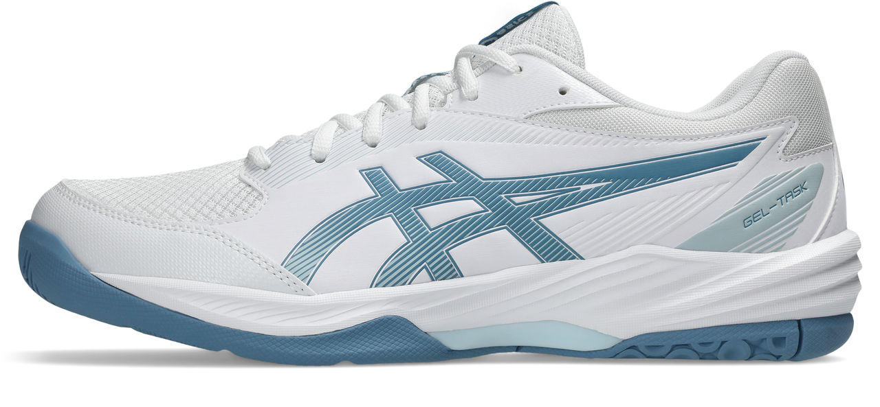
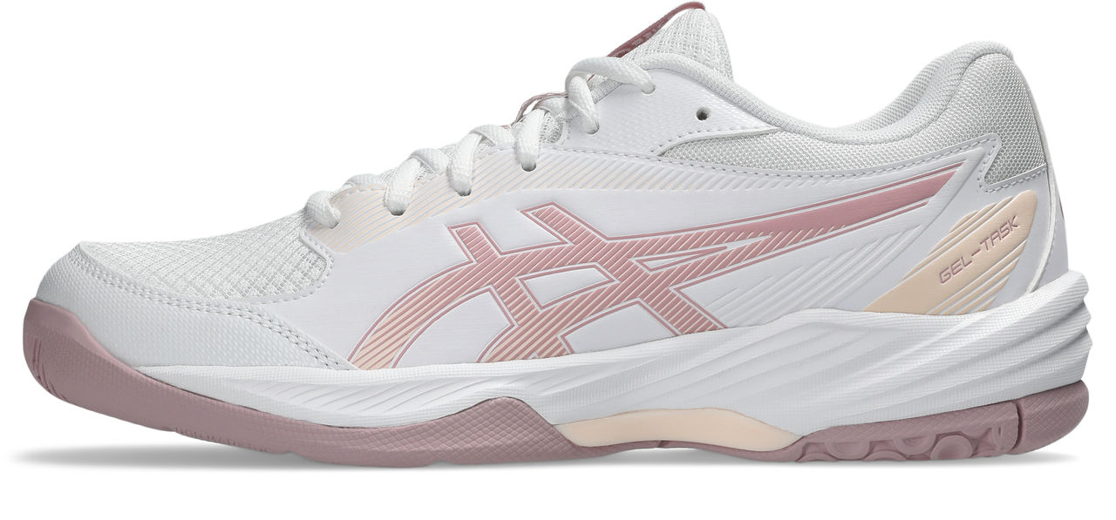
INDOOR MEN
HIGHER
GEL-TASK 4
103
CUD
€95
JAN
SILVER
1071A103
INDOOR WOMEN
HIGHER
GEL-TASK 4
105
CUD
€95
JAN
SILVER
1072A106
SS26 VLP – CPS FTW

Slide 14
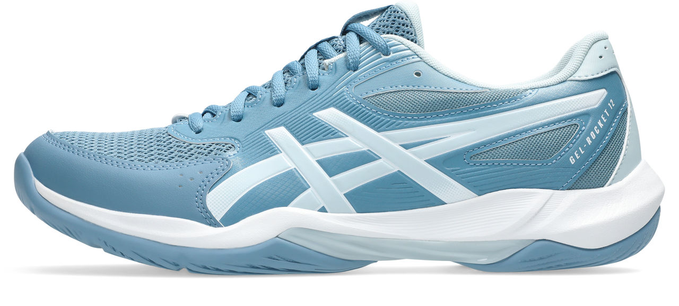
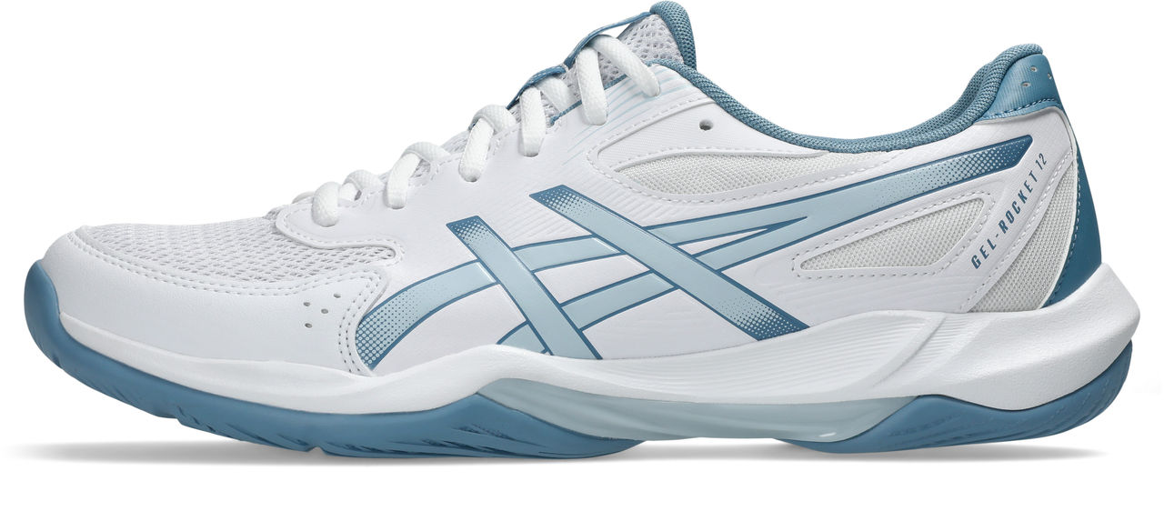
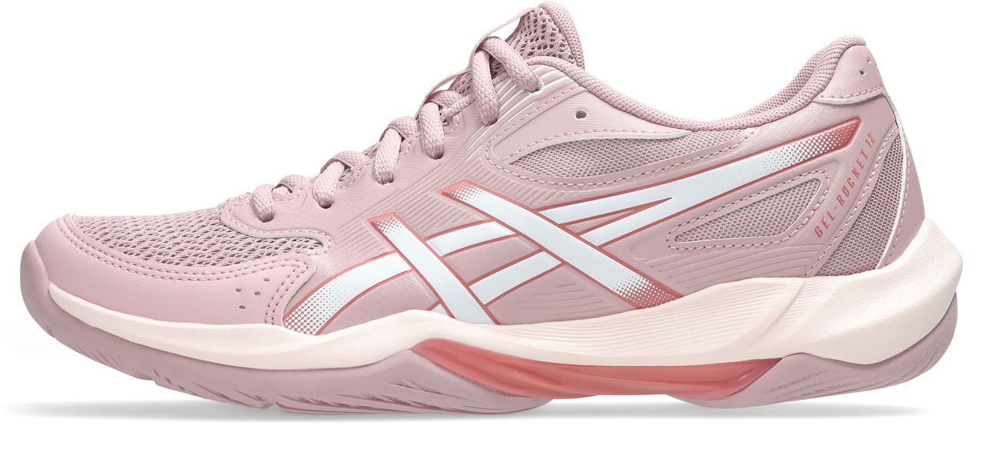
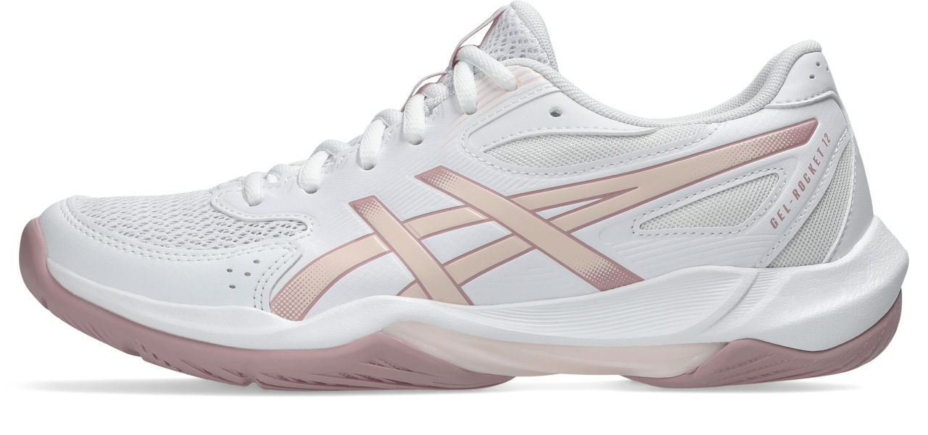
INDOOR MEN
STRONGER
GEL-ROCKET 12
401
103
CUD
€79
JAN
SILVER
1071A116
INDOOR WOMEN
STRONGER
GEL-ROCKET 12
700
103
CUD
€79
JAN
SILVER
1072A119
SS26 VLP – CPS FTW

Slide 15
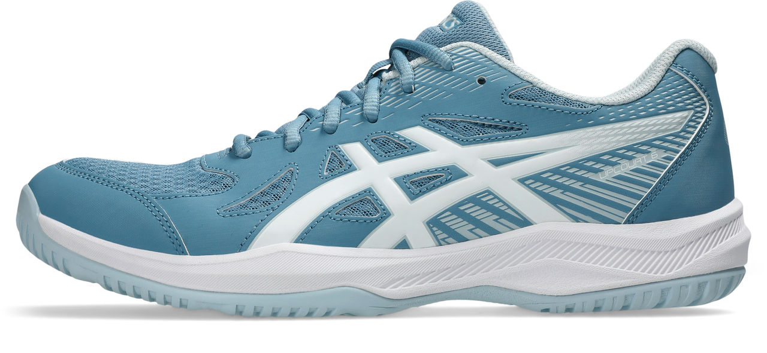
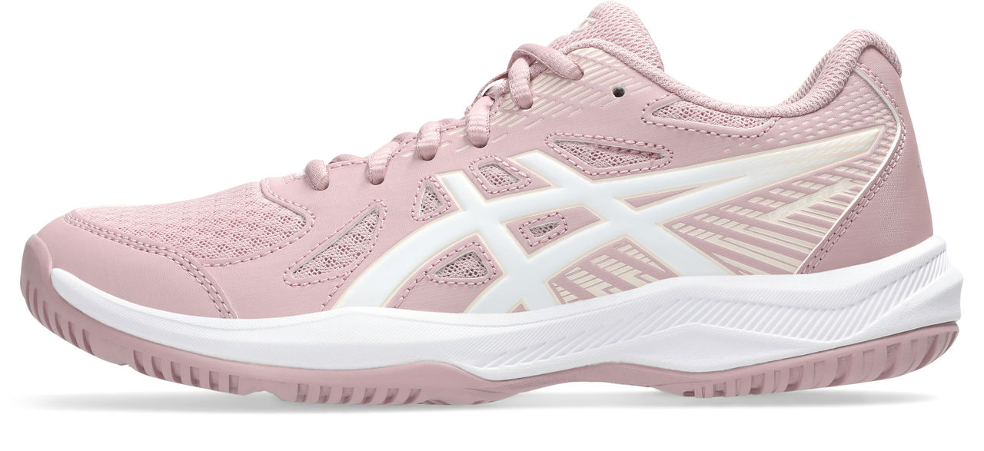
INDOOR MEN
FASTER
UPCOURT 6
404
CUD
€69
JAN
BRONZE
1071A104
INDOOR WOMEN
FASTER
UPCOURT 6
703
CUD
€69
JAN
BRONZE
1072A107
SS26 VLP – CPS FTW

Slide 16
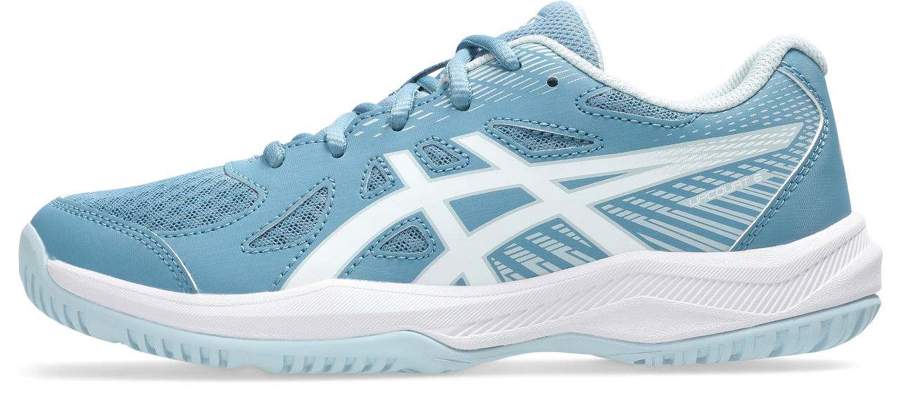
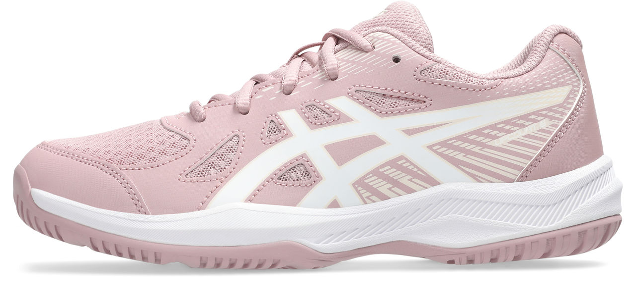
INDOOR KIDS
UPCOURT 6 GS
403
702
CUD
€59
JAN
BRONZE
1074A045
SS26 VLP – CPS FTW

Slide 17
WRESTLING
SS26 VLP – CPS FTW

Slide 18
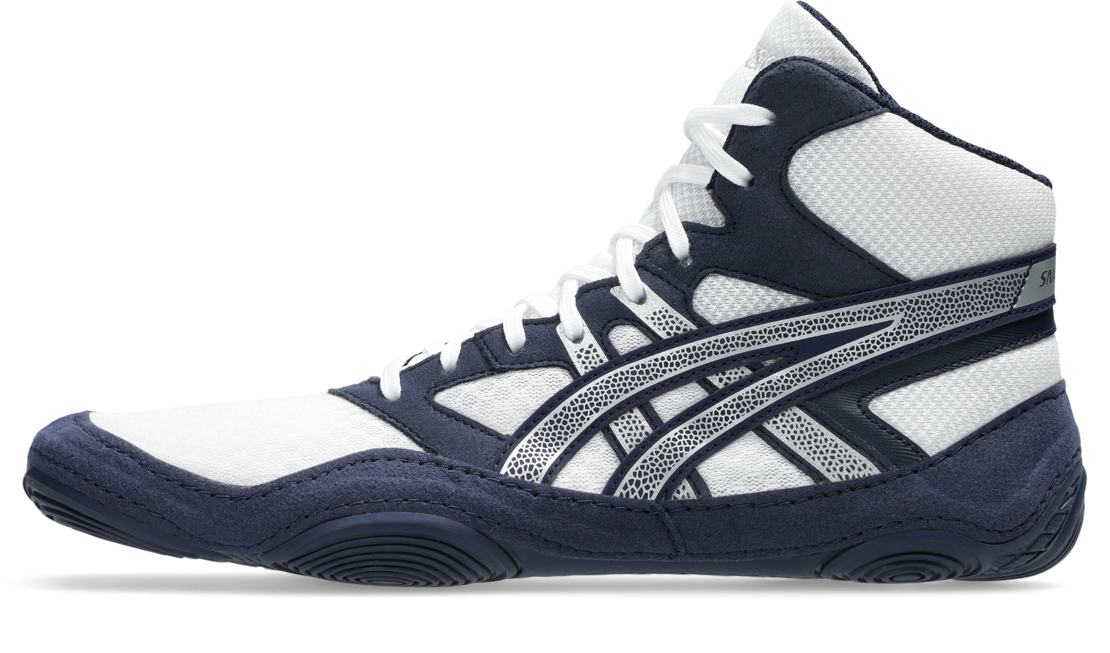
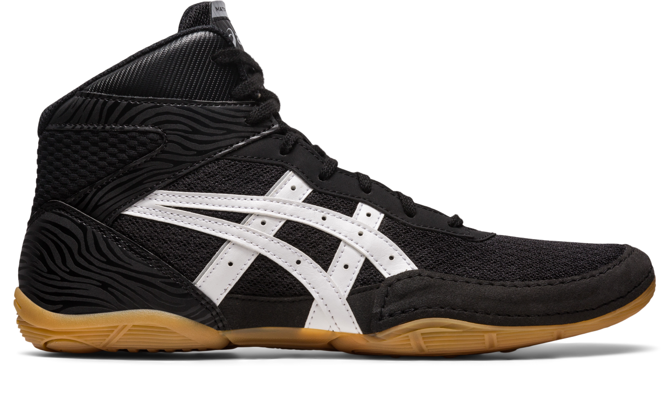
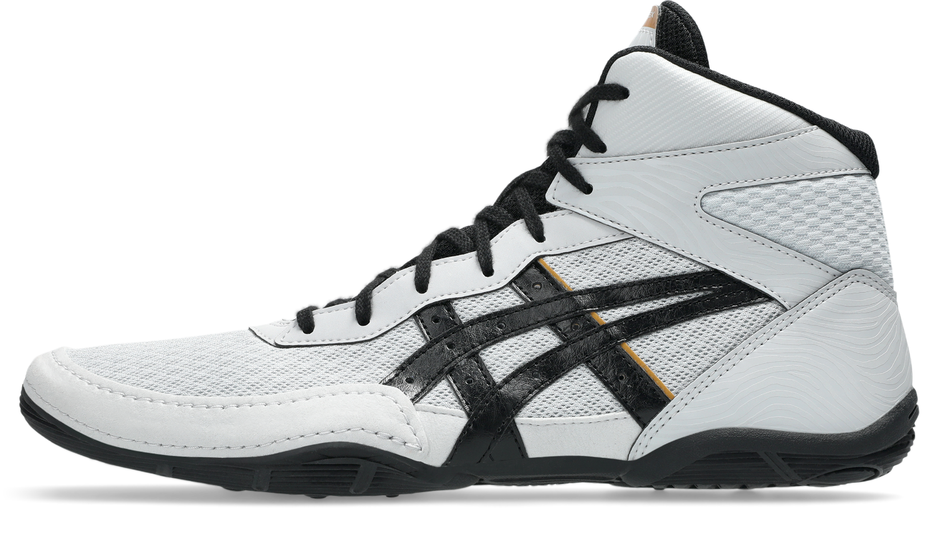
WRESTLING UNISEX
SNAPDOWN 4
401
CO
€95
DEC ‘25
SILVER
1081A058
MATFLEX 7
001
022
CO
€80
DEC ‘25
SILVER
1081A051
SS26 VLP – CPS FTW

