Slide 1
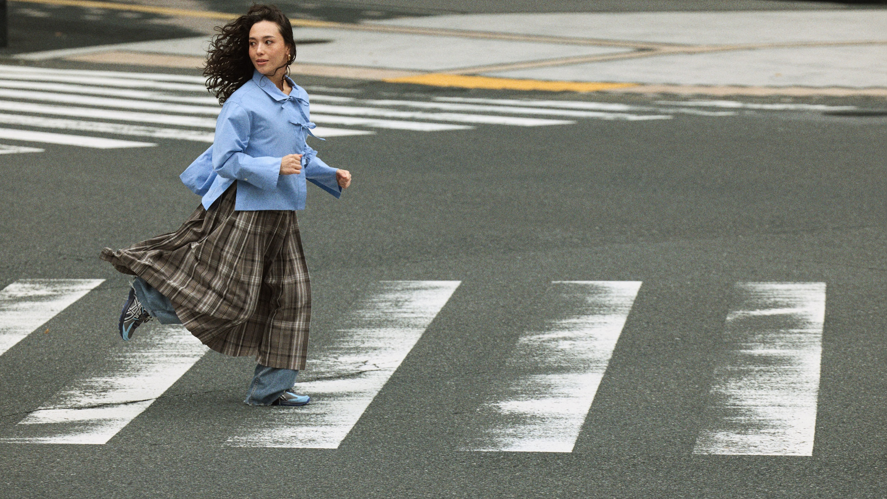

ASICS SPORTSTYLE
SS26 VLP
The contents of this document are the proprietary and confidential information of ASICS Corporation and intended solely for informational purposes and internal use. You are prohibited from copying, reproducing, disseminating or otherwise providing this information to, or use for the benefit of, any third party. Such dissemination or improper use may result in penalties. ASICS reserves all legal rights. If you have received this communication in error or do not agree to the above, please return this material to ASICS.

Slide 2
VIS-TECH

Slide 3
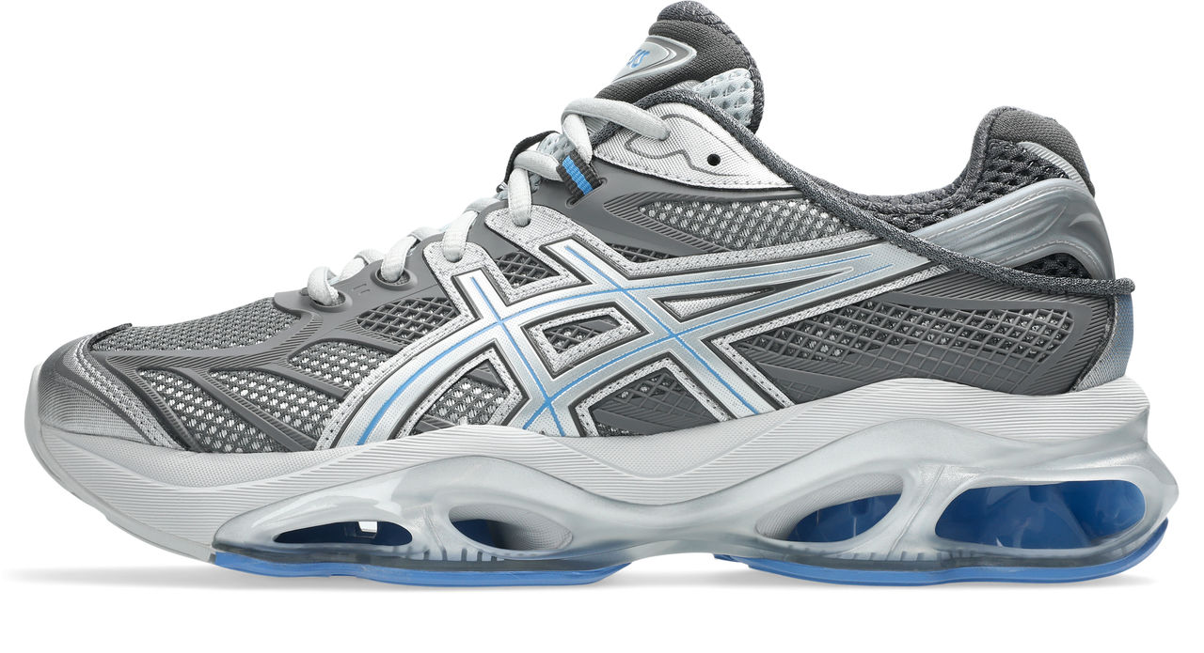
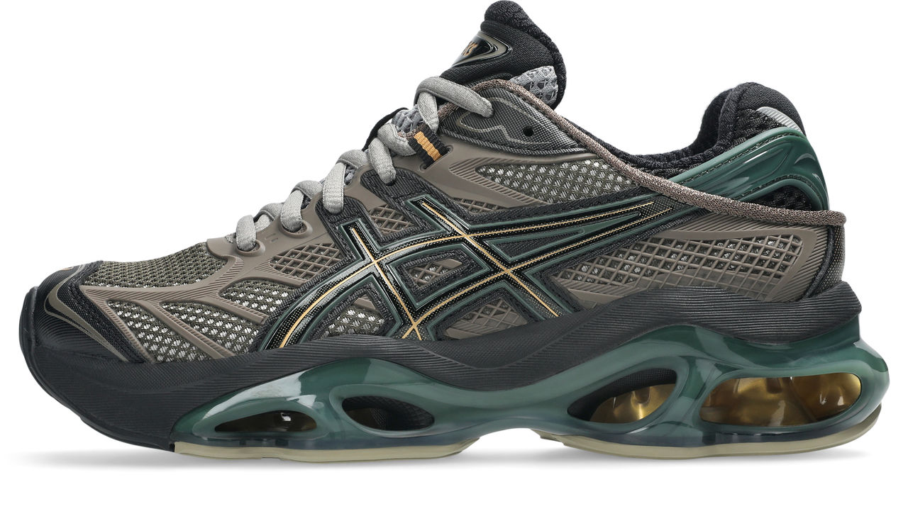
GEL-KINETIC 2.0
GEL-KINETIC 2.0
1203A678
NEW
UNI
BASE
€240
022
023
PLATINUM PLUS

Slide 4
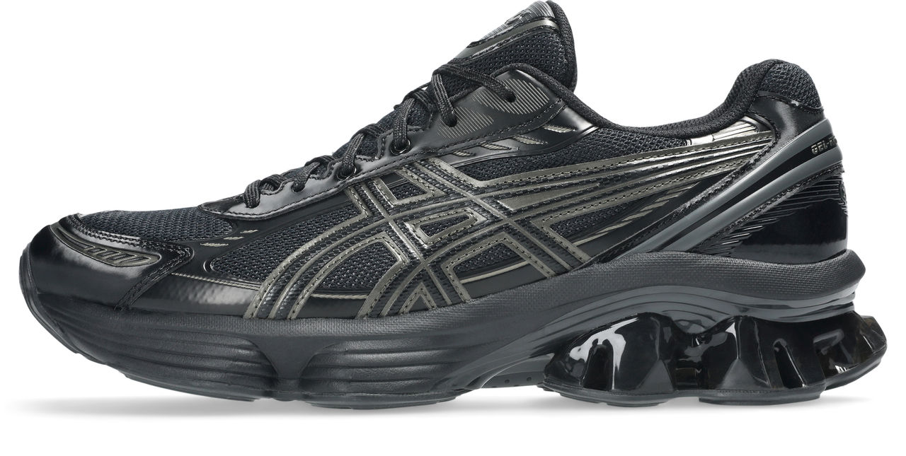
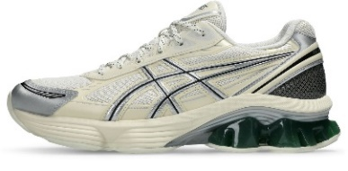
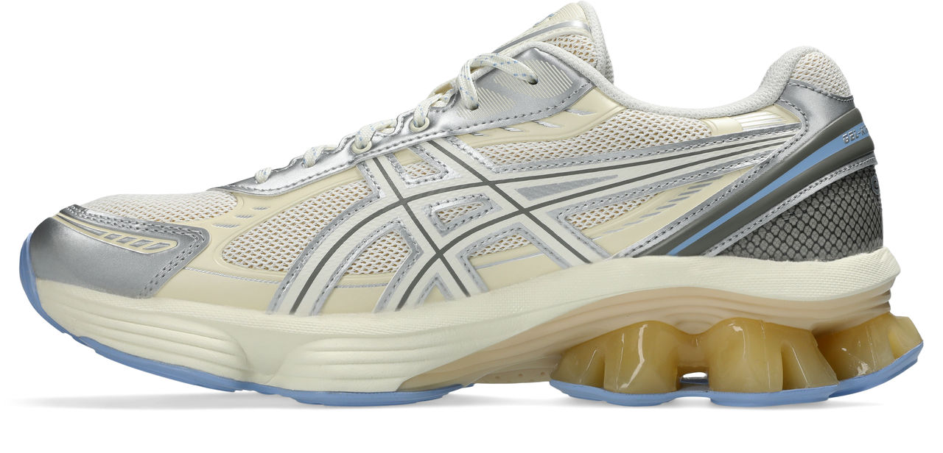
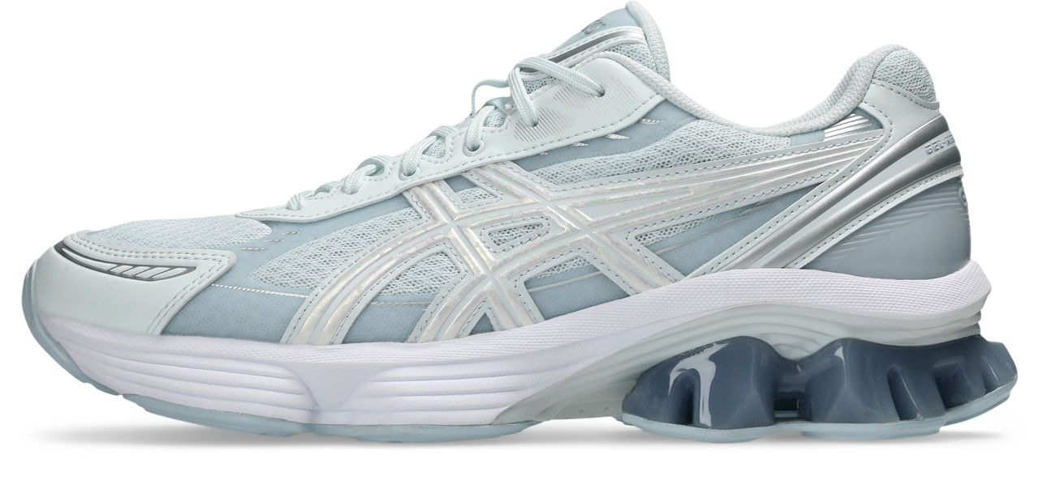
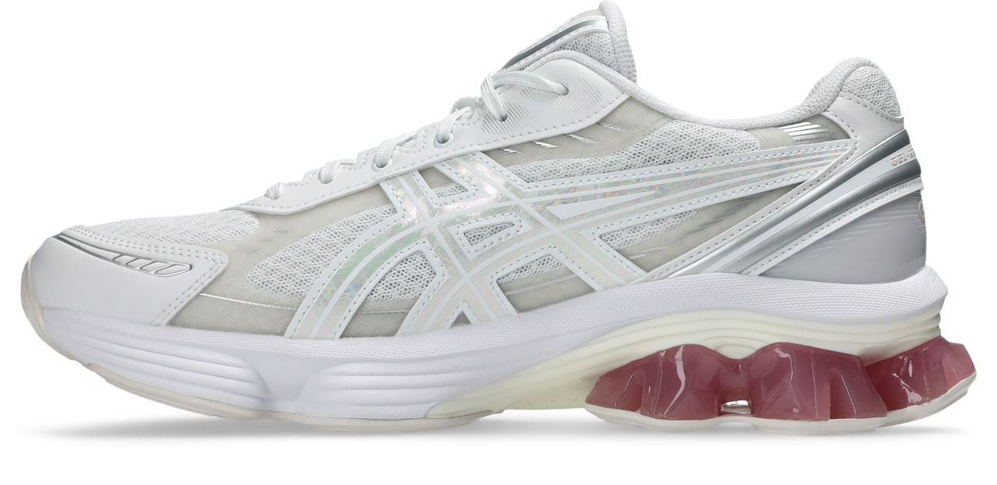
GEL-KINETIC fluent
GEL-KINETIC FLUENT
1203A591
CUD
UNI
BASE
€175
003
105
103
GEL-KINETIC FLUENT
1203A892
MUD
UNI
AURORA
€175
400
100
PLATINUM

Slide 5
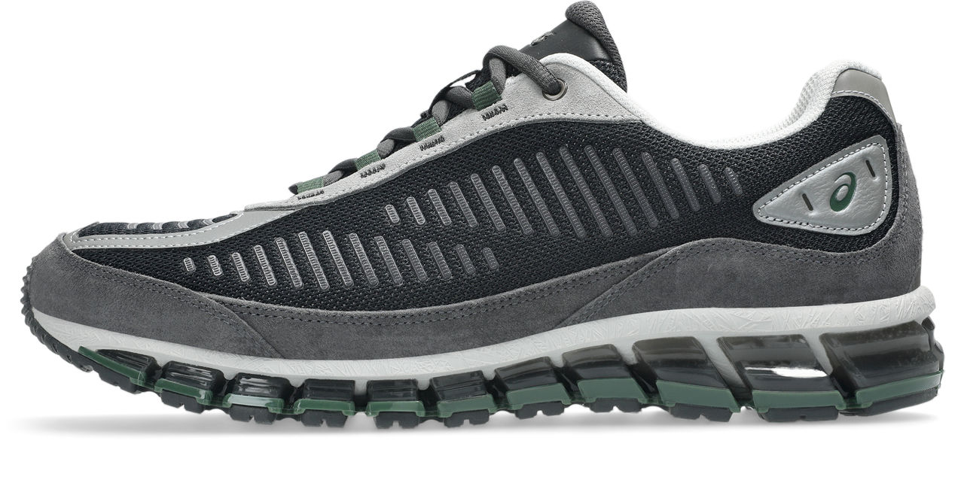
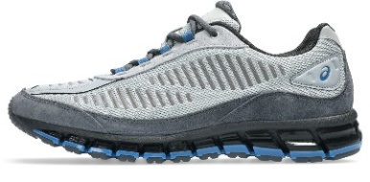
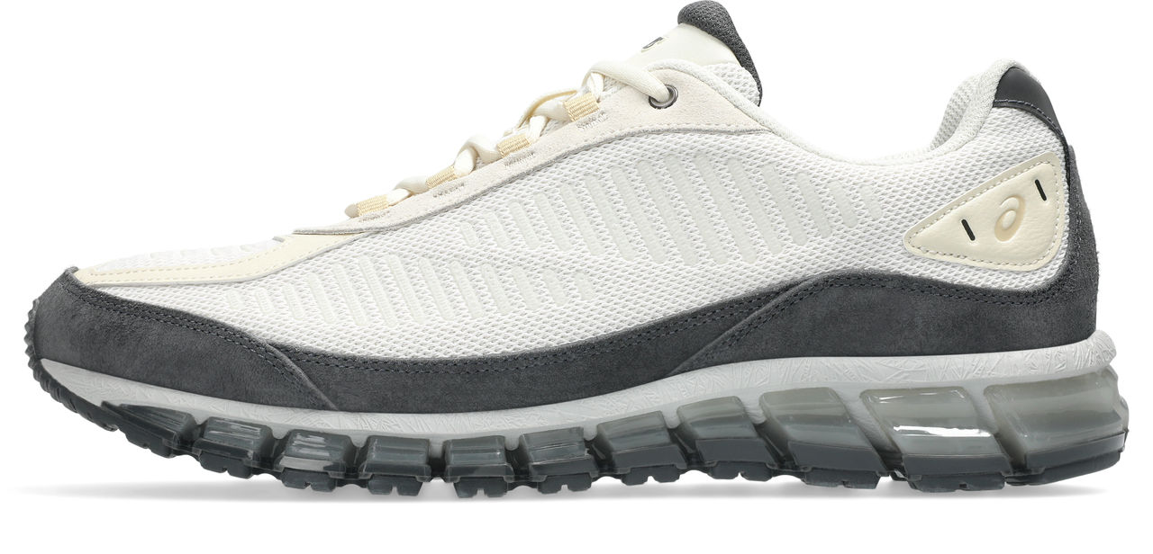
GEL-quantum 360 I amp
GEL-QUANTUM 360 I AMP
1203A731
CUD
UNI
BASE
€190
002
021
100
PLATINUM PLUS

Slide 6
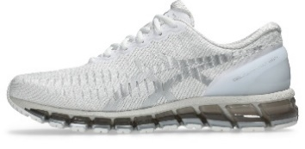
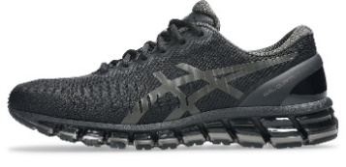
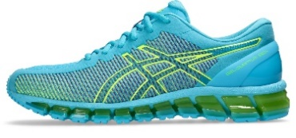
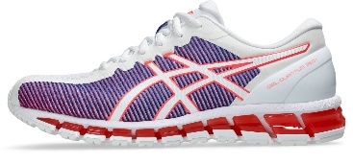
GEL-quantum 360 I / cm
GEL-QUANTUM 360 I
1203A730
CUD
UNI
BASE
€190
101
001
GEL-QUANTUM 360 I CM
1203A893
MUD
UNI
CM
€190
400
PLATINUM
100

Slide 7
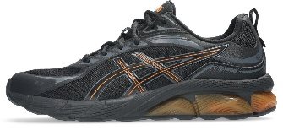
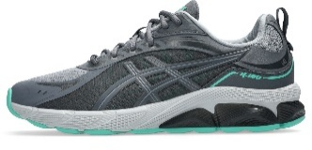
GEL-quantum 180 viii
GEL-QUANTUM 180 VIII
1203A594
CUD
UNI
BASE
€150
007
022
GOLD

Slide 8
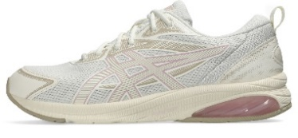
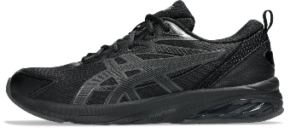
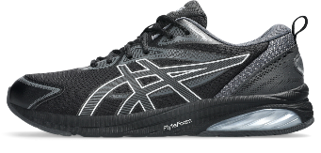
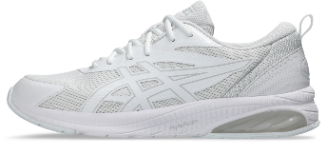
GEL-quantum kei (page 2 of 2)
GEL-QUANTUM KEI
1203A601
CUD
UNI
BASE
€100
105
SILVER
GEL-QUANTUM KEI
1203A601
CARRY OVER
UNI
€100
001
C/O
004
C/O
100
C/O

Slide 9
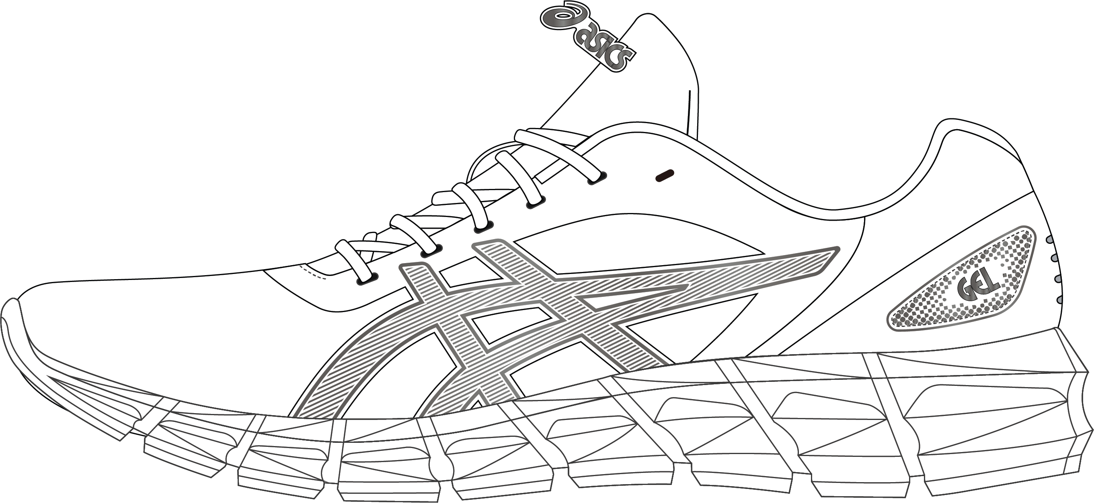
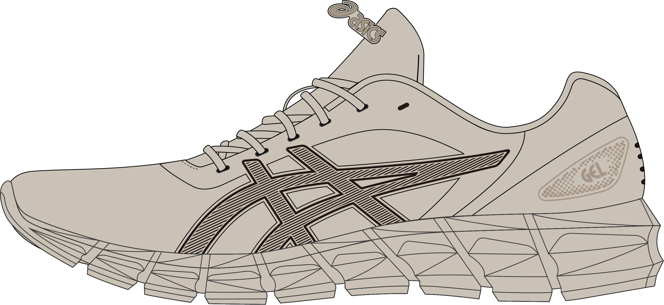
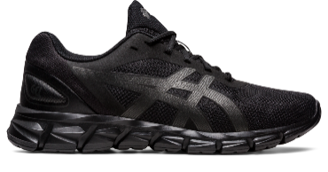
GEL-QUANTUM LYTE II
GEL-QUANTUM LYTE II
1203A906
CARRY OVER
UNI
€85
100
C/O
020
C/O
GEL-QUANTUM LYTE II
1201A630
CARRY OVER
MEN
€85
005
C/O
SILVER

Slide 10
VINTAGE TECH

Slide 11
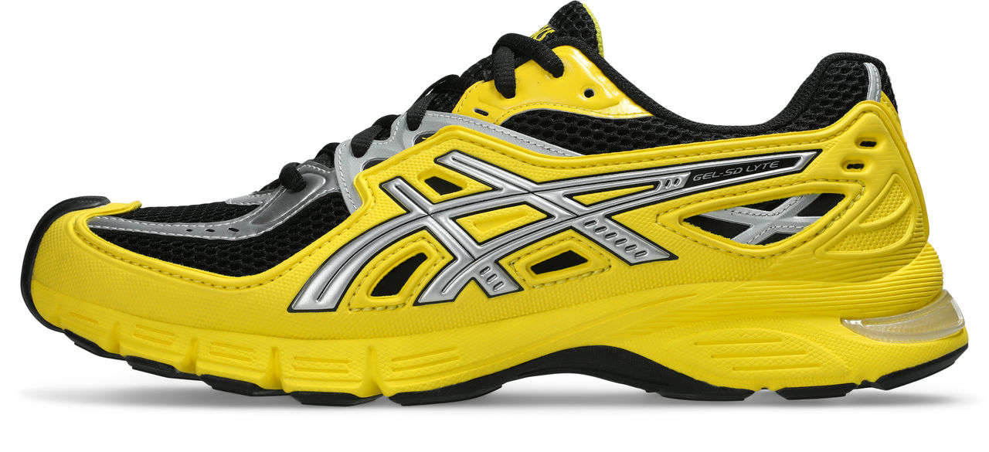
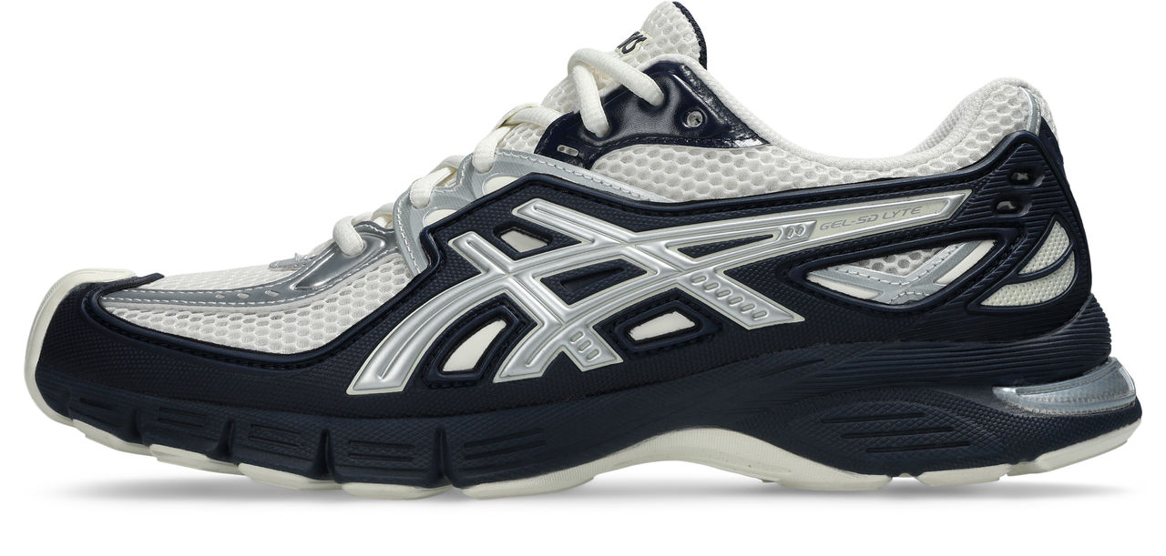
GEL-sd-lyte
GEL-SD-LYTE
1203A886
NEW
UNI
BASE
€175
750
400
PLATINUM PLUS

Slide 12
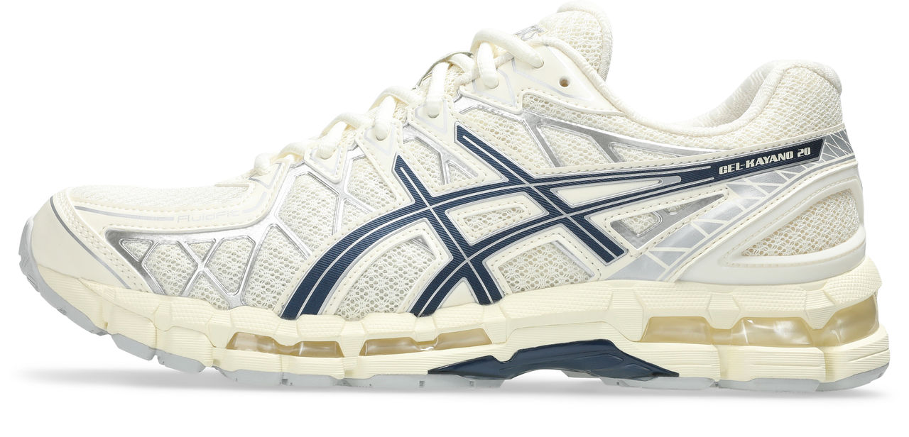
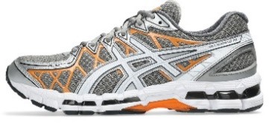
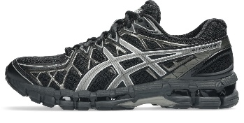
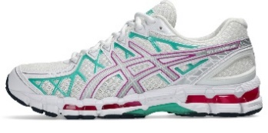
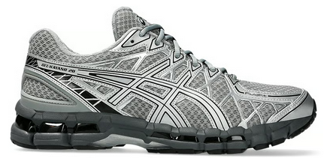
GEL-kayano 20
104
023
GEL-KAYANO 20
1203A388
CUD
UNI
OG
€185
003
105
020
PLATINUM

Slide 13
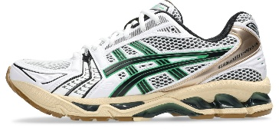
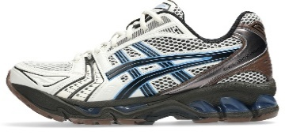
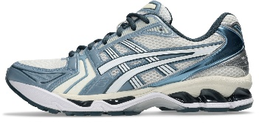
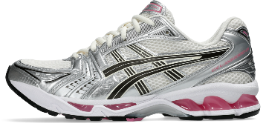
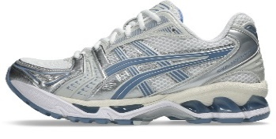
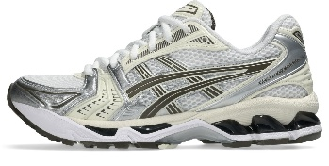
GEL-kayano 14
GEL-KAYANO 14
1203A740
CUD
UNI
OG - 2 TONE MESH
€175
103
104
PLATINUM PLUS
GEL-KAYANO 14
1203A537
CUD
UNI
OG
€175
116
103
C/O
115
111
PLATINUM

Slide 14
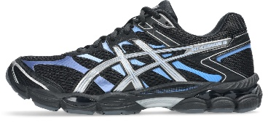
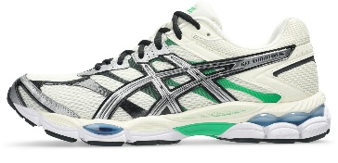
GEL-CUMULUS 16 (PAGE 1 OF 2)
GEL-CUMULUS 16
1203A888
MUD
UNI
SPORTY MESH
€155
001
750
PLATINUM PLUS

Slide 15
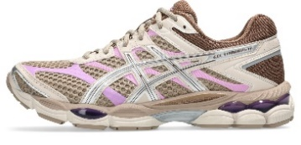
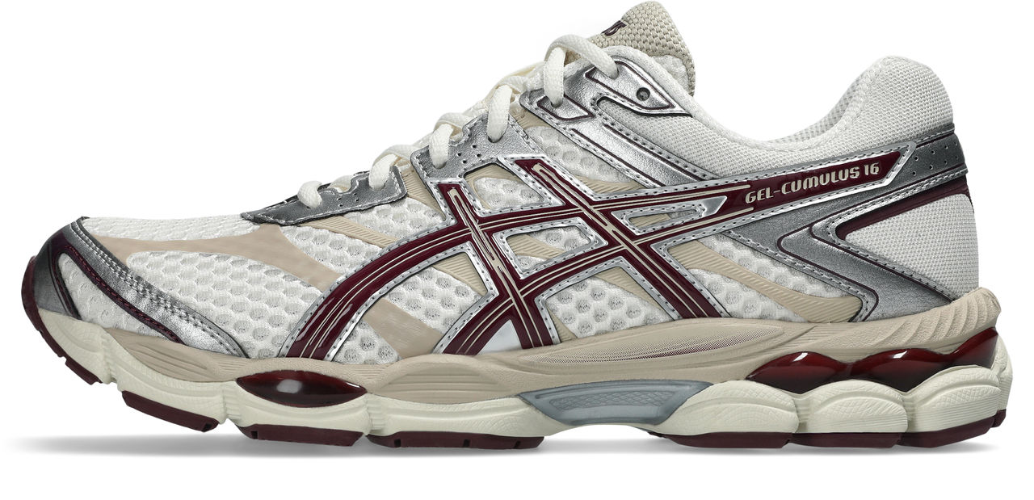
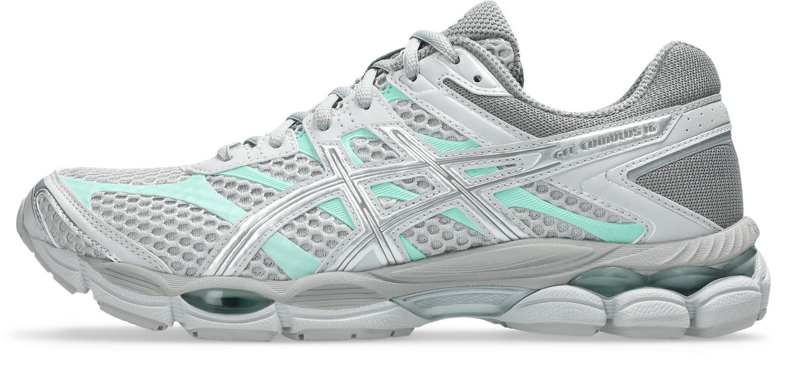
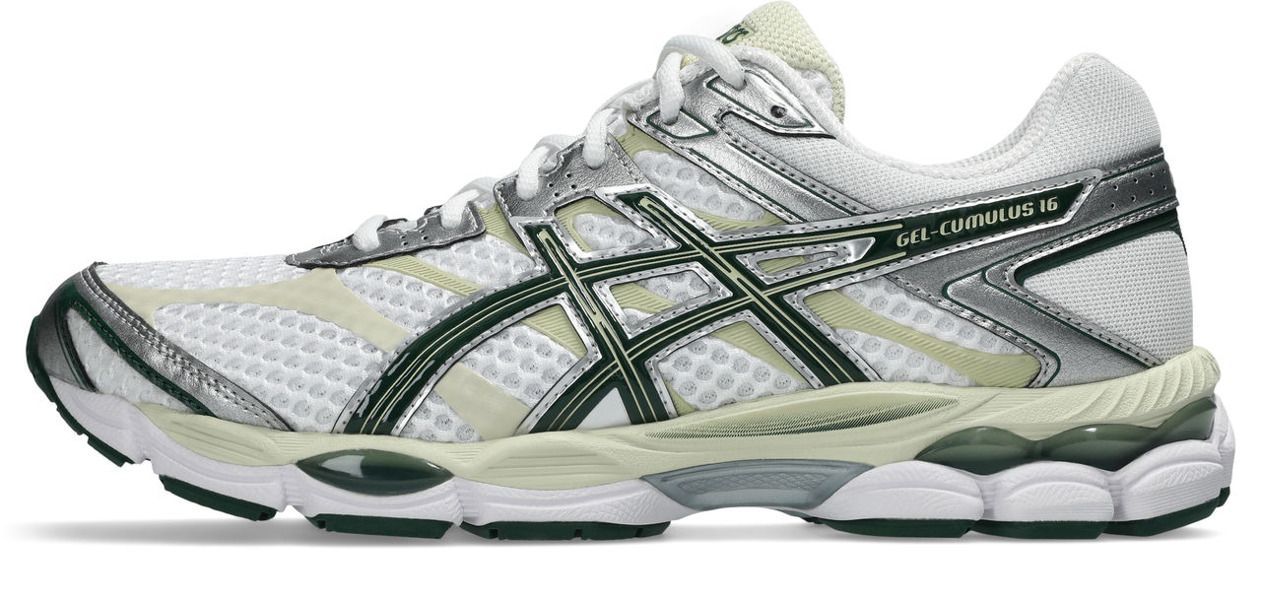
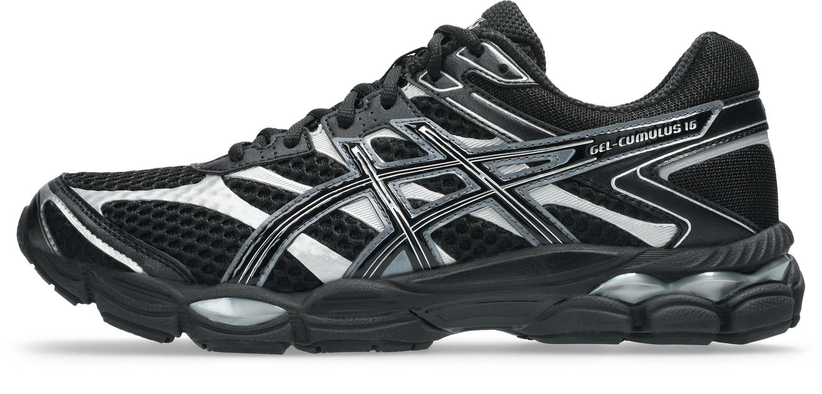
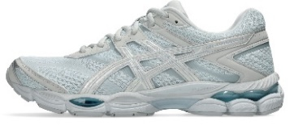
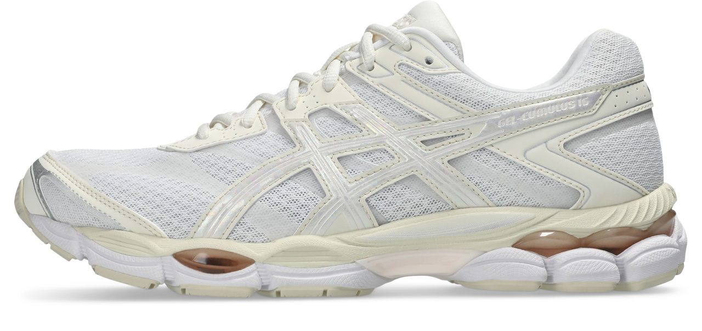
GEL-CUMULUS 16 (PAGE 2 OF 2)
GEL-CUMULUS 16
1203A733
CUD
UNI
OG
€155
104
200
021
105
002
PLATINUM
GEL-CUMULUS 16
1203A887
MUD
UNI
AURORA
€165
400
100

Slide 16
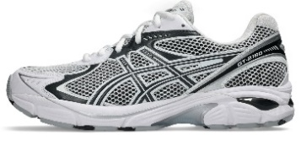
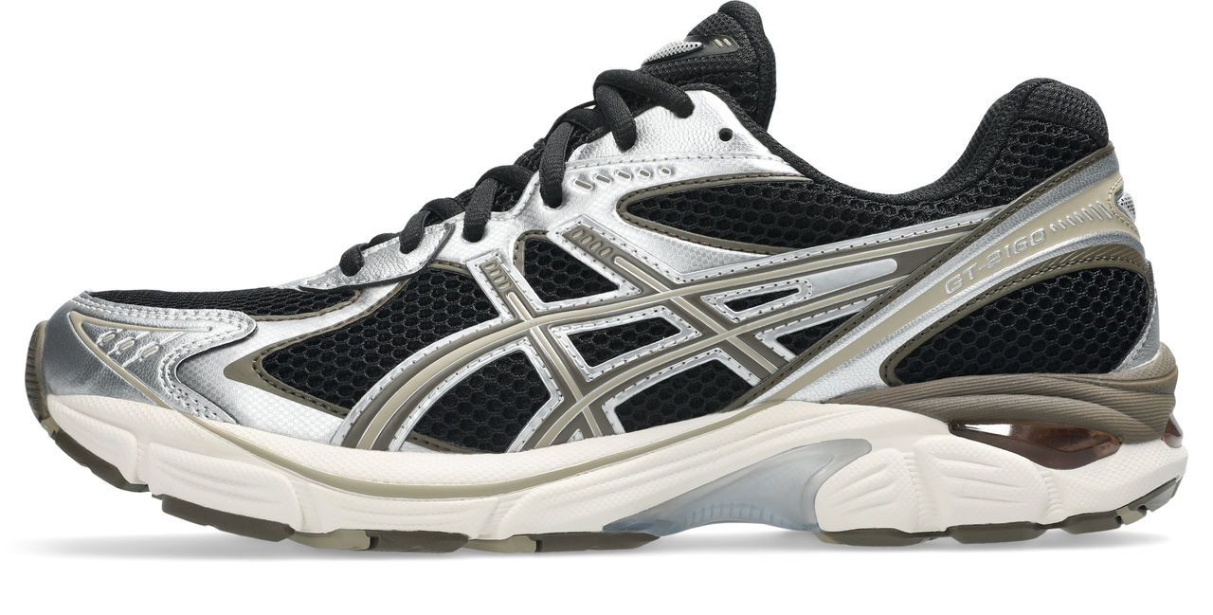
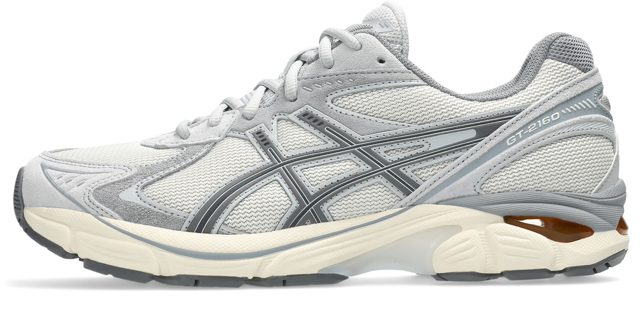
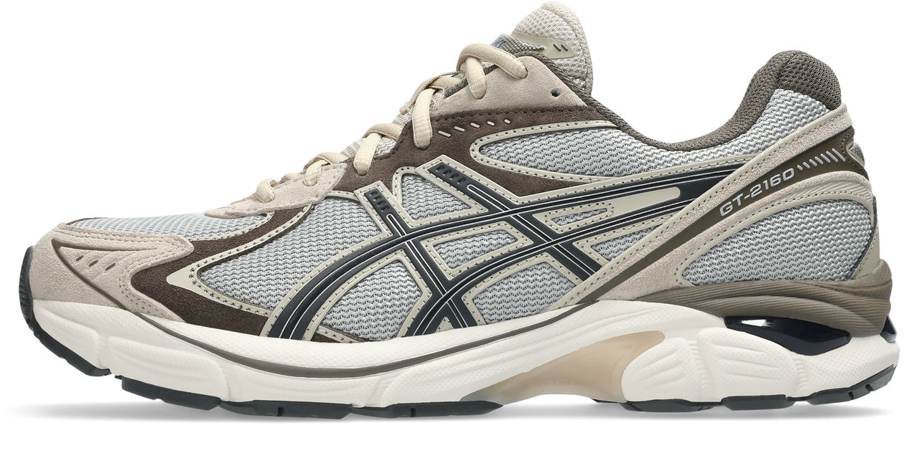

GT-2160
GT-2160
1203A275
CUD
UNI
OG
€135
115
004
GT-2160
1203A605
CUD
UNI
SUEDE/MESH
€135
101
022
PLATINUM
GT-2160
1203A980
CUD
UNI
€135
100

Slide 17






GEL-1130 (PAGE 1 OF 3)
GEL-1130
1203B045
MUD
UNI
PATENT
€115
020
200
GEL-1130
1203A899
MUD
UNI
MESH/JEWEL
€110
102
101
103
100
PLATINUM

Slide 18








GEL-1130 (PAGE 2 OF 3)
GEL-1130
1203A609
CUD
UNI
OG
€110
110
109
106
111
107
108
GOLD
001
250

Slide 19



GEL-1130 (PAGE 3 OF 3)
Confidential and proprietary information. Intended solely for informational purposes and internal use. Not for distribution.
GEL-1130
1201A906
CARRY OVER
MEN
BASE
€110
001
C/O
GEL-1130
1201B019
CARRY OVER
MEN
BASE
€110
100
C/O
GEL-1130
1201B020
CARRY OVER
MEN
BASE
€110
100
C/O
GOLD

Slide 20


JOG 100S (PAGE 1 OF 2)
JOG 100S
1203B043
MUD
UNI
SPIRAL VAMP
€110
TBC1
TBC2
PLATINUM

Slide 21
HYBRID

Slide 22





GEL-kayano 12.1
GEL-KAYANO 12.1
1203A759
CUD
UNI
BASE
€185
104
105
250
002
103
PLATINUM PLUS

Slide 23






GEL-NIMBUS 10.1
GEL-NIMBUS 10.1
1203A543
CUD
UNI
BASE
€175
108
110
005
024
PLATINUM PLUS
GEL-NIMBUS 10.1
1203A761
CUD
UNI
PANEL PLAY
€175
102
001

Slide 24





GEL-nyc 2.0
GEL-NYC 2.0
1203A895
NEW
UNI
BASE (SUEDE)
€155
100
021
022
102
101
PLATINUM
PLATINUM [KA]

Slide 25














GEL-nyc (PAGE 1 OF 2)
GEL-NYC
1203A383
CUD
UNI
BASE
€155
404
028
750
201
303
116
114
113
GEL-NYC
1203A739
CUD
UNI
CLOSE MESH
€165
021
301
251
401
PLATINUM
GEL-NYC
1203A280
CUD
UNI
LEATHER/MESH
€165
003
021

Slide 26



GEL-nyc (PAGE 2 OF 2)
GEL-NYC
1203A897
MUD
UNI
2-TONE SUEDE
€165
200
001
PLATINUM
GEL-NYC
1201A789
CARRY OVER
MEN
€155
103
C/O

Slide 27
URBAN TRAIL

Slide 28





GEL-venture 6 & GEL-ventX
GEL-VENTURE 6
1203A908
CUD
UNI
BASE
€115
021
GEL-VENTX
1203B040
NEW
UNI
€110
201
PLATINUM
100
001
200

Slide 29

GEL-nunobiki
GEL-NUNOBIKI
1203A536
CUD
UNI
BASE
€115
004
GOLD

Slide 30
COURT

Slide 31


GEL-RESOLUTION 5
GEL-RESOLUTION 5
1203A901
NEW
UNI
BASE
€165
400
100
PLATINUM PLUS

Slide 32



JAPAN S (PAGE 1 OF 2)
JAPAN S
1203A615
CUD
UNI
BASE
€90
108
110
SILVER

Slide 33
CLASSIC HERITAGE

Slide 34


LYTE CLASSIC
LYTE CLASSIC
1203A611
CUD
UNI
MESH/SUEDE
€89
001
201
SILVER

Slide 35
KIDS

Slide 36




GEL-1130 KIDS (PAGE 1 OF 2)
GEL-1130 GS
1204A169
CUD
KIDS
OG
€89
105
020
700
GOLD
GEL-1130 GS
1204A169
CARRY OVER
KIDS
BASE
€89
001
C/O

Slide 37



KIDS
GEL-QUANTUM LYTE II GS
1204A186
CARRY OVER
KIDS
BASE
€65
600
C/O
JAPAN S GS
1204A007
CUD
KIDS
BASE
€59
135
136
SILVER

